Slide 1
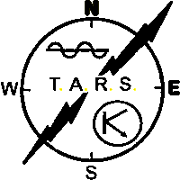
Part 3 TARS Robot and how to submit logs for TARS Contest
John Bogdaniec 2E0SPS

Slide 2
Introduction to Electronic QSO Logging Recap
Part 1 - QRZ.com Introduction
Part 2 - Log4OM logging program introduction
Log4OM to QRZ.com QSO Integration
Part 3 - TARS Robot and how to submit logs for TARS Contest + Fun Event
Part 4 - Minos Contest logging program introduction for RSGB VHF & UHF Contests - TBD
Part 5 - N1MM contest logging program introduction – TBD
Part 6 - Contest logging hands on contest event - TBD

Slide 3
Part 3 – TARS Robot Account
Register For Account
Login to Your Account and Robot Navigation
Station Configuration Tab
Awards Tab
Results Tab
Robot Help
Upload .adi File to TARS Robot
Re-Visit .adi File Exports
Live Upload to Robot – QRZ.com or Log4OM .adi File
TARS Robot Wrap-Up

Slide 4
Part 3 – Register for TARS Robot Account

Slide 5
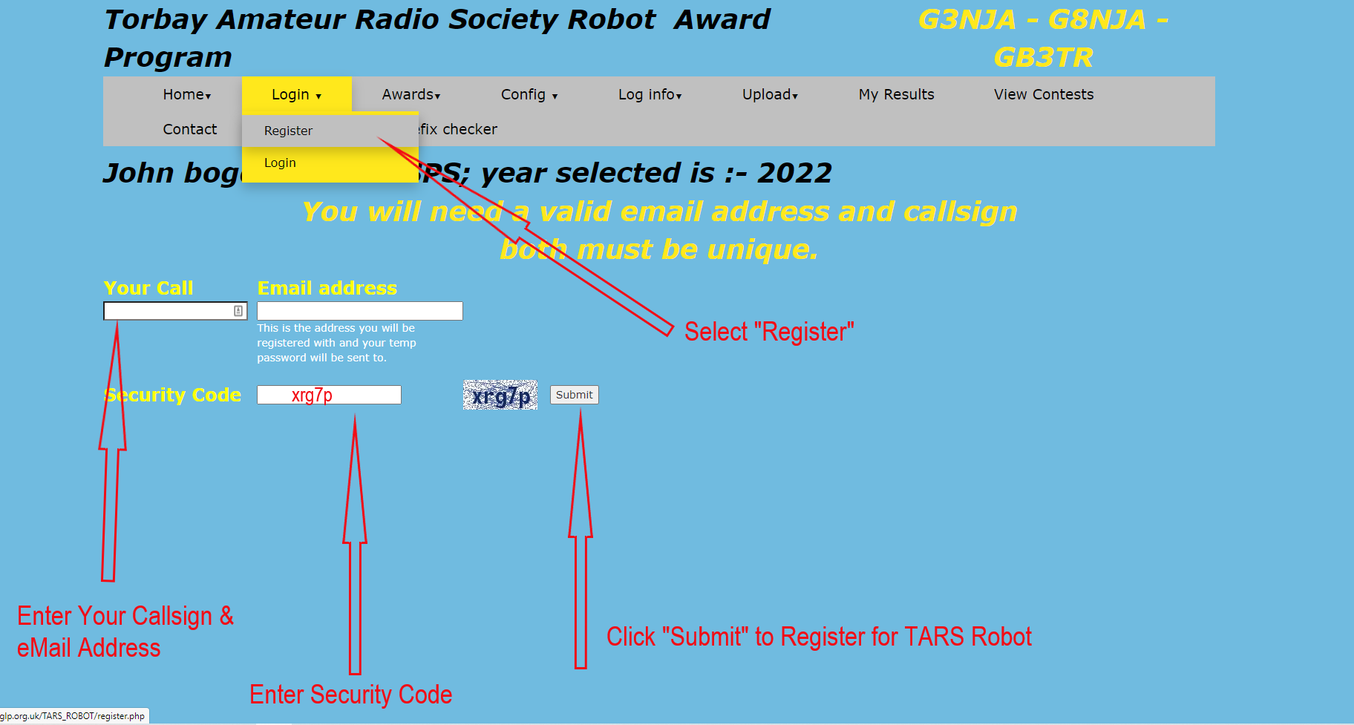
Part 3 – Register for TARS Robot Account

Slide 6
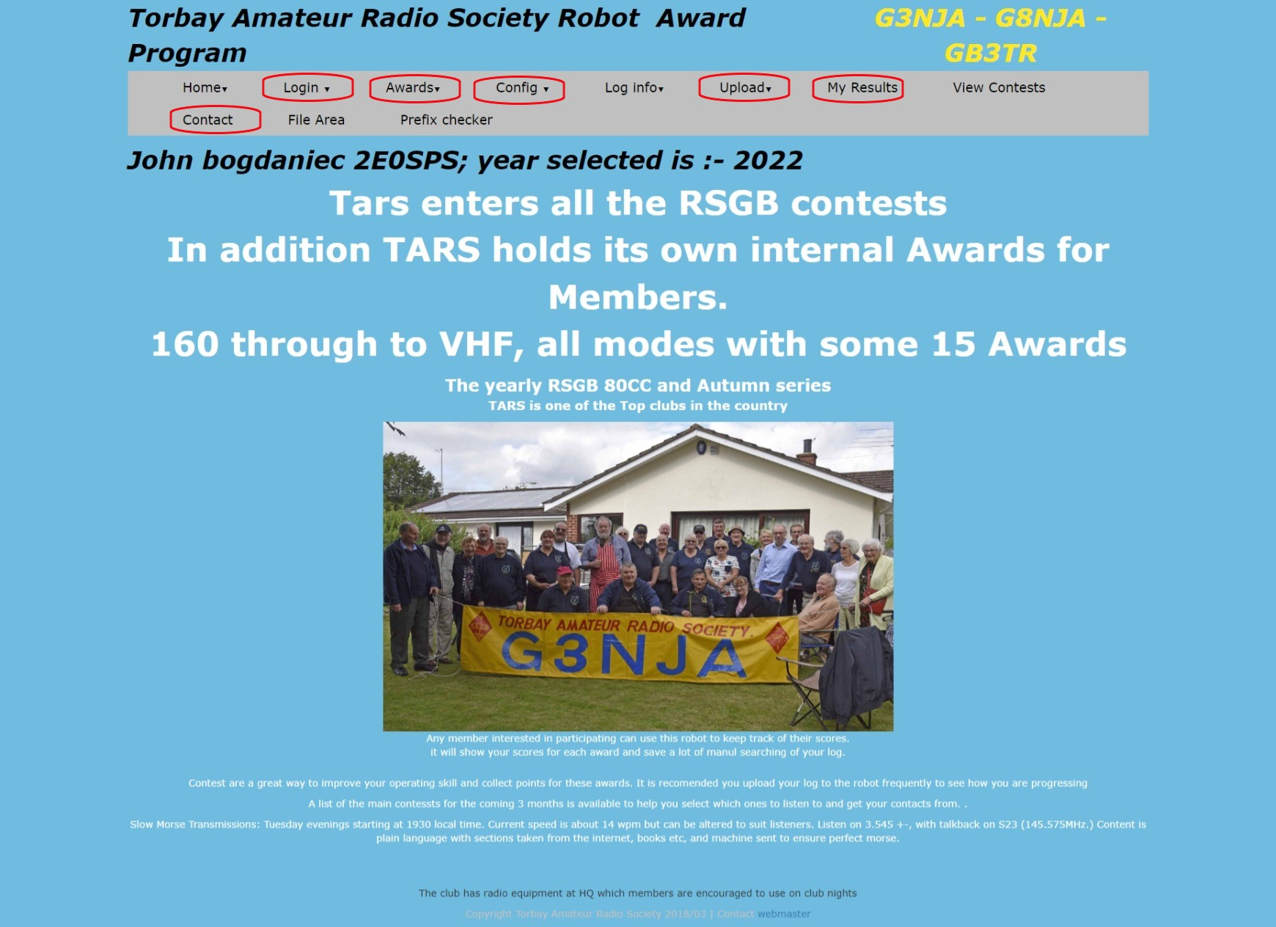
Part 3 – Robot Navigation Page

Slide 7
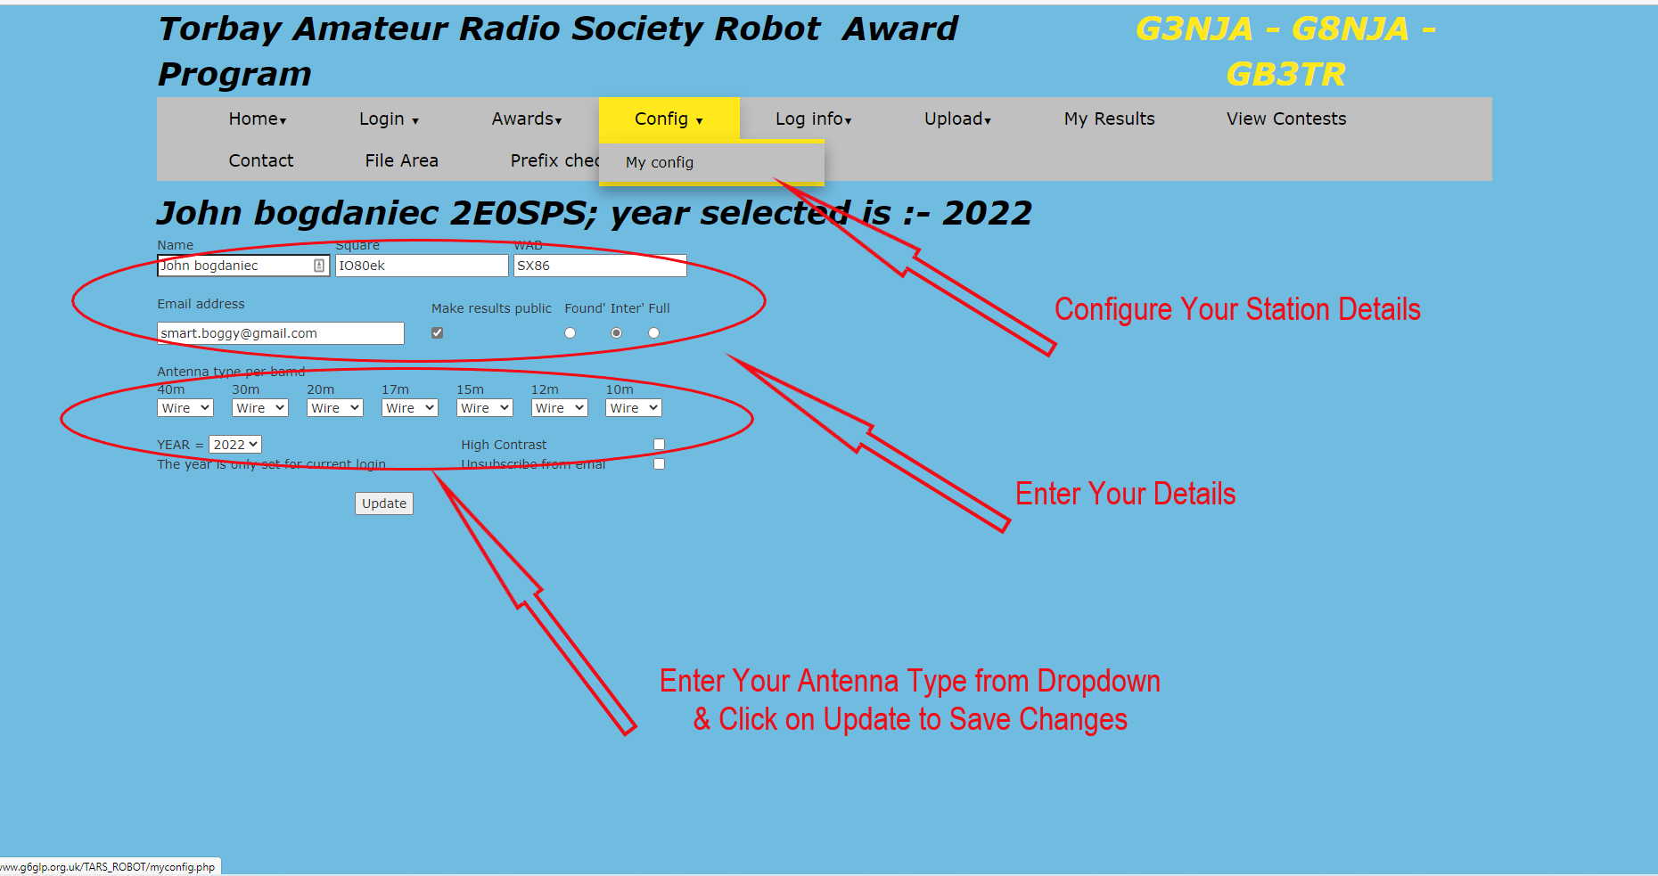
Part 3 – Station Configuration Tab

Slide 8
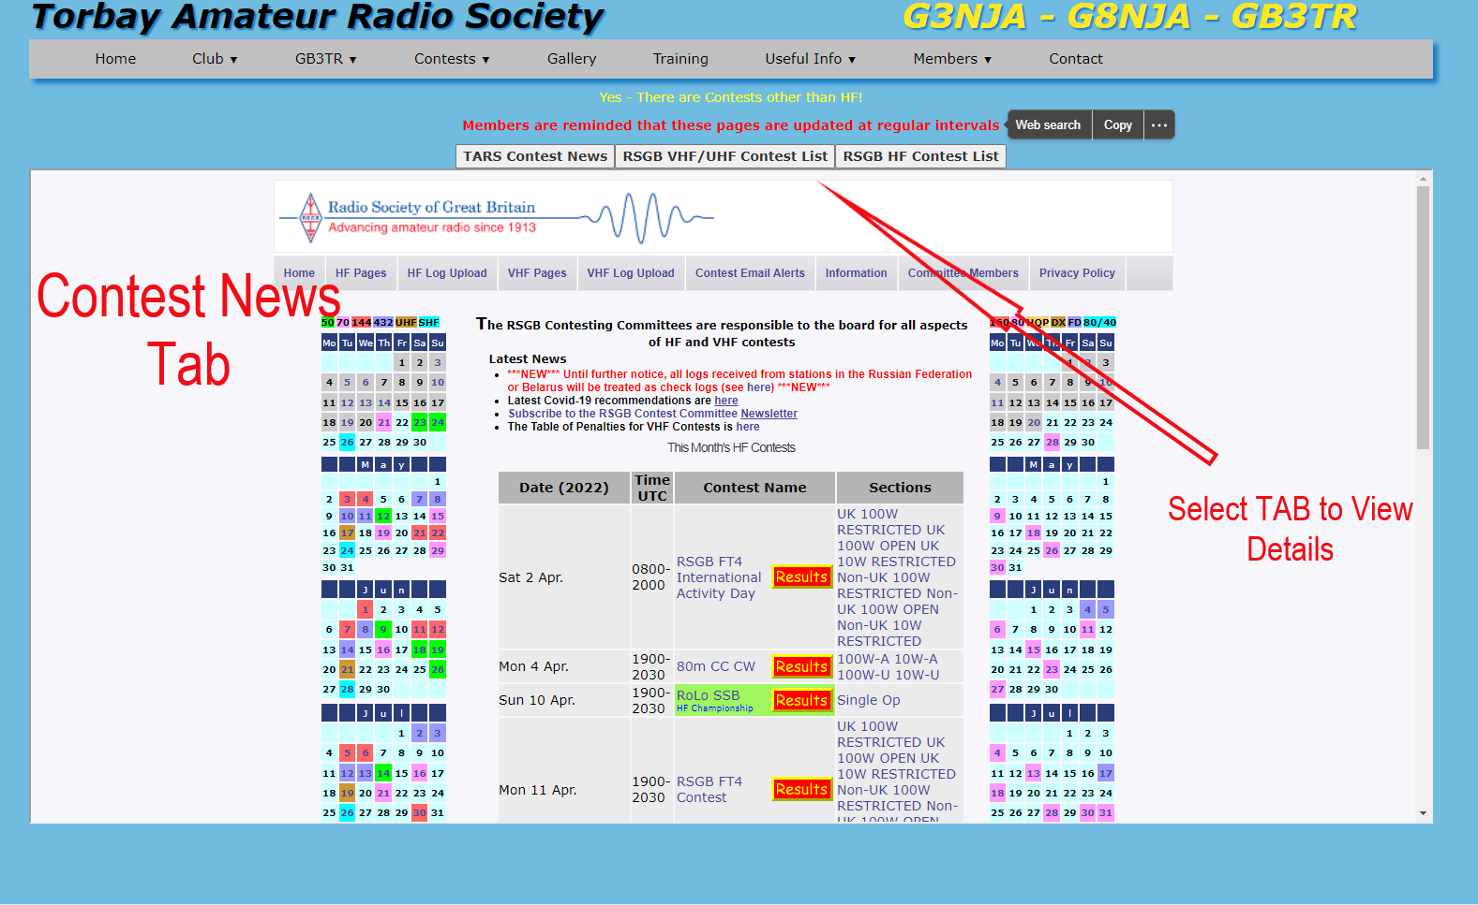
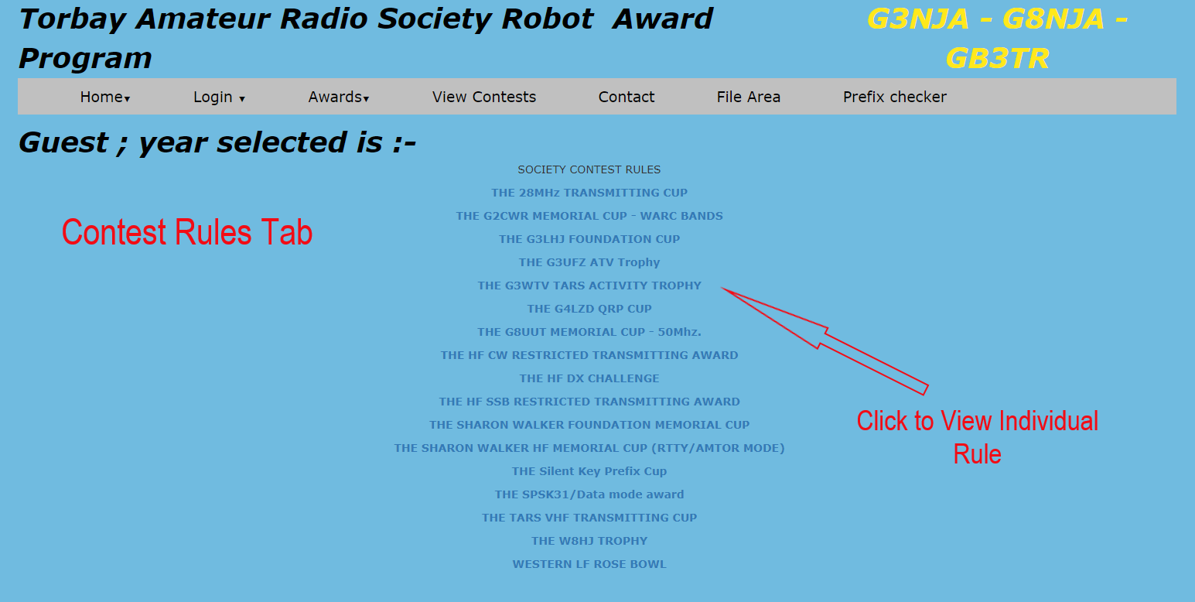
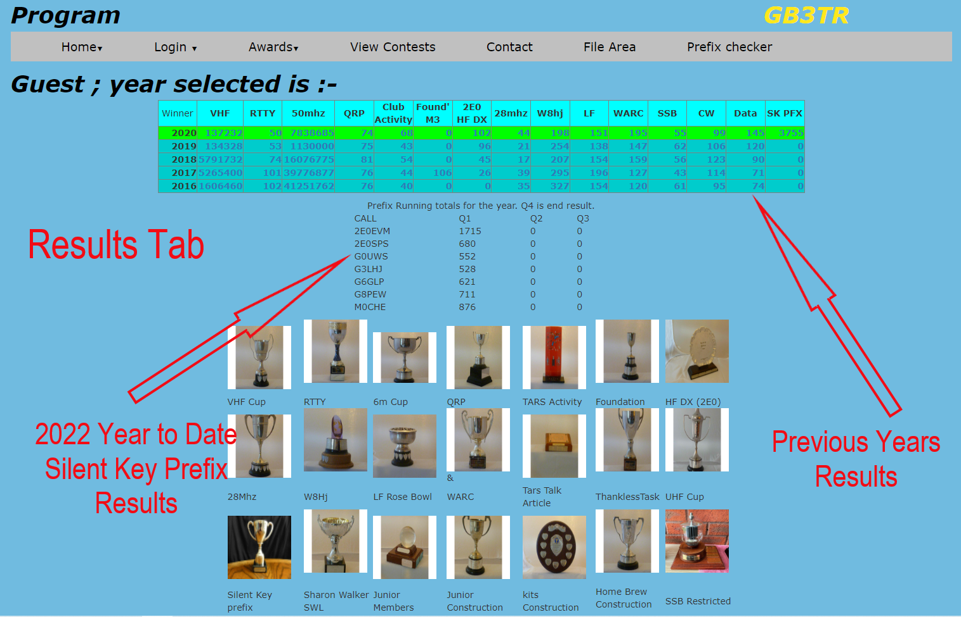
Part 3 – Awards Tab

Slide 9
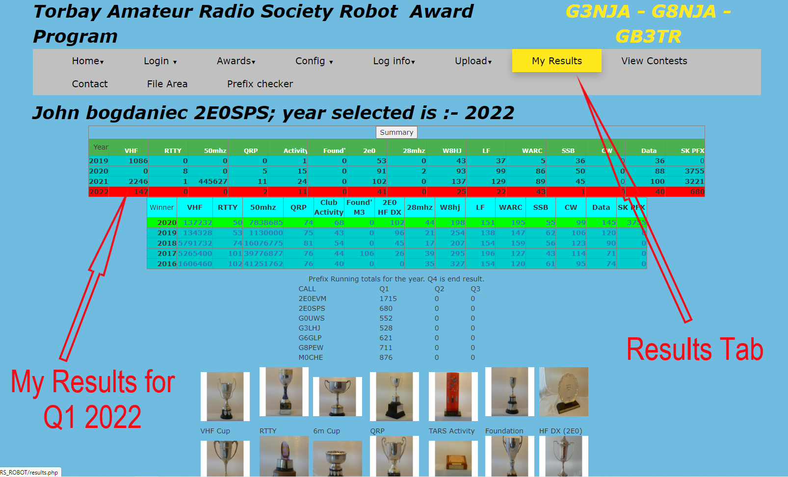
Part 3 – Results Tab

Slide 10
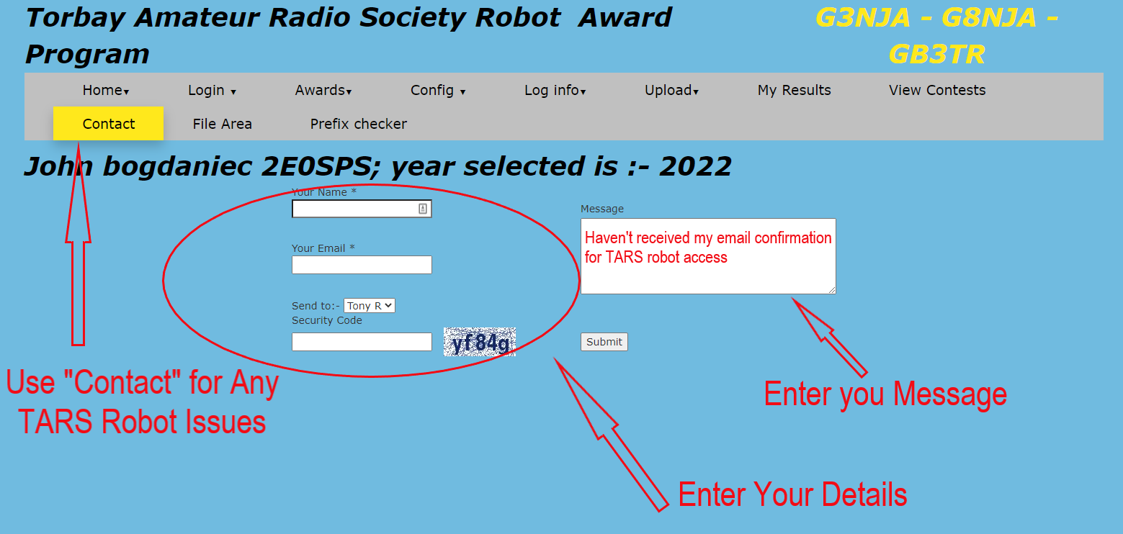
Part 3 – Robot Help

Slide 11
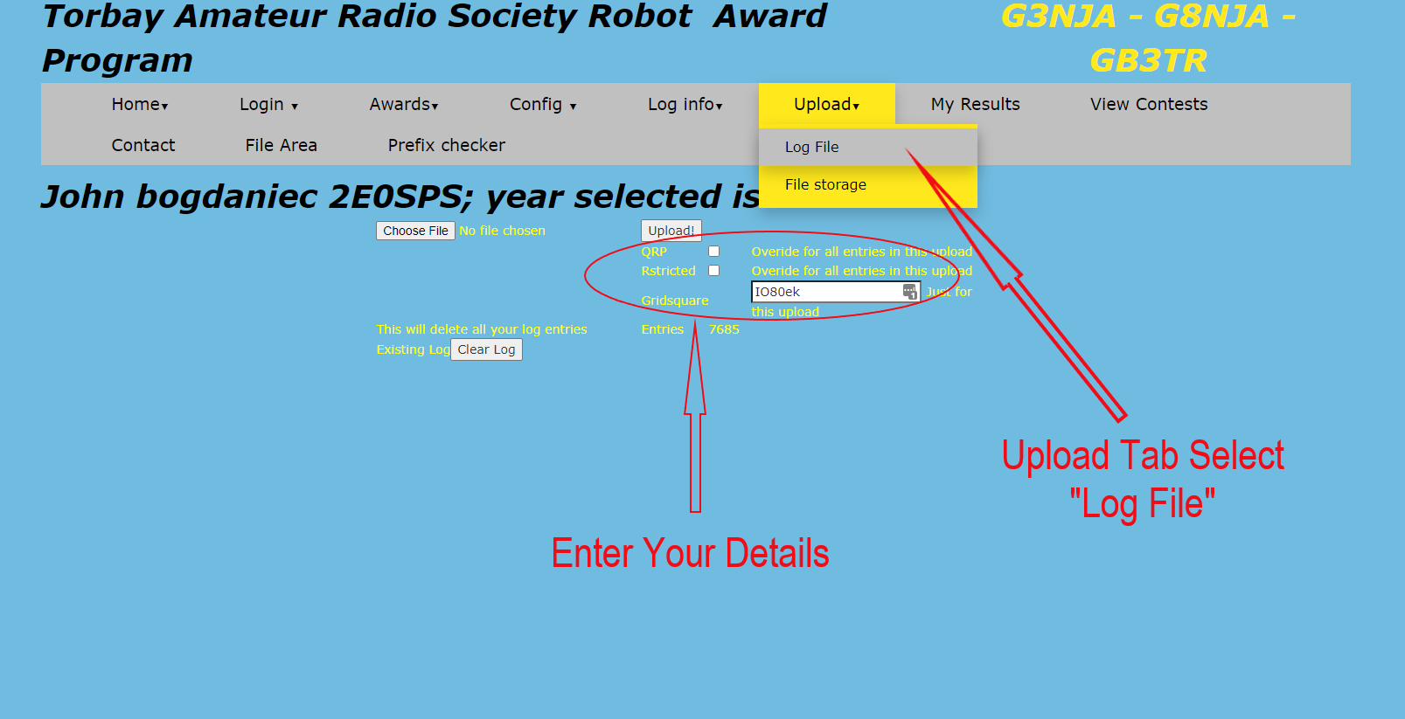
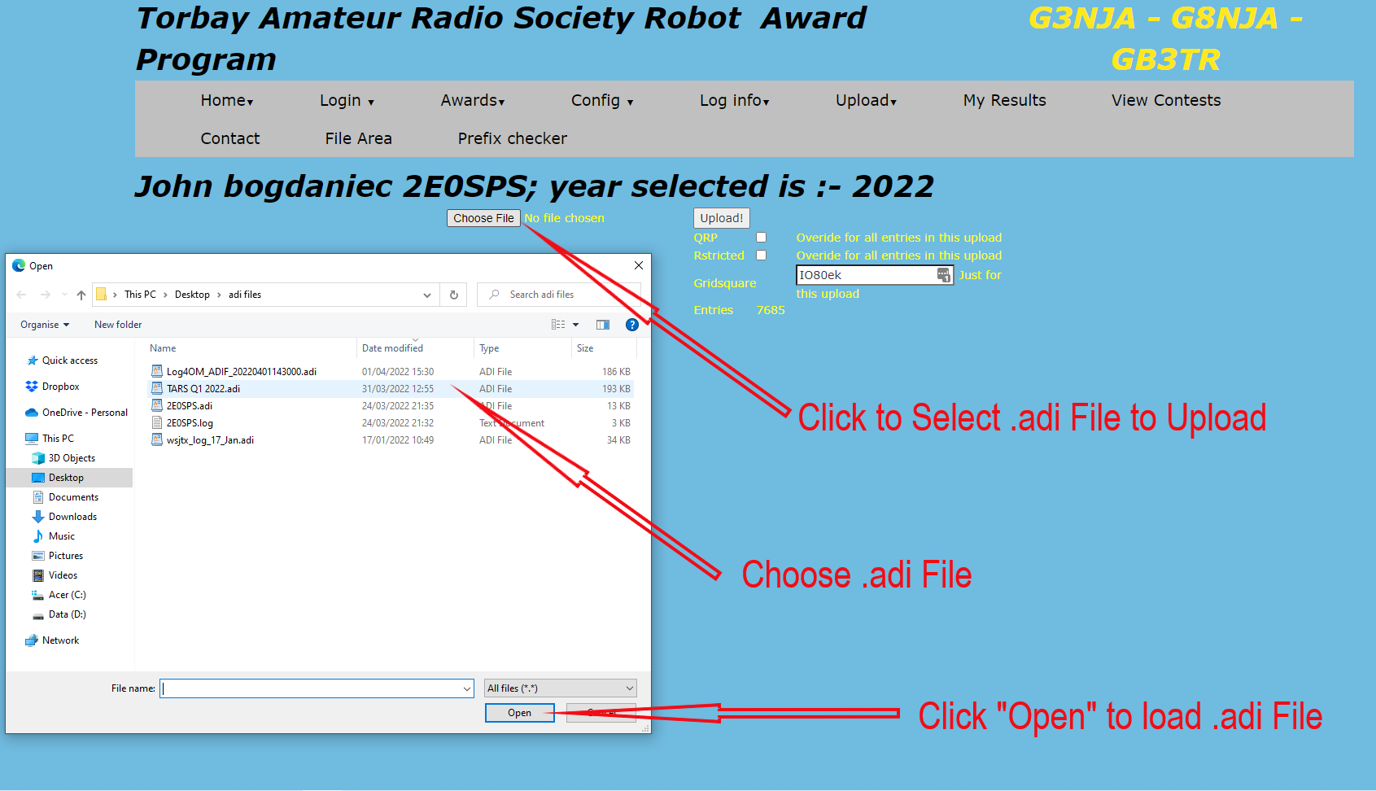
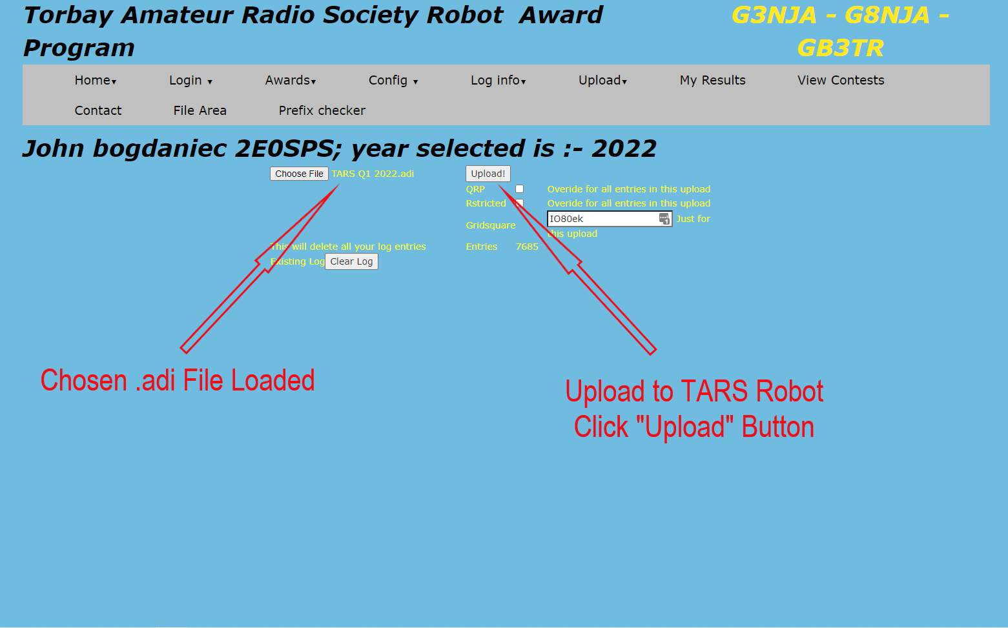
Part 3 –Ready to Upload to TARS Robot

Slide 12
Part 3 – Re-Visit File Exports
Part 1 – QRZ Logbook Filters & .adi File Export
Part 2 – Log4OM .adi File Export

Slide 13
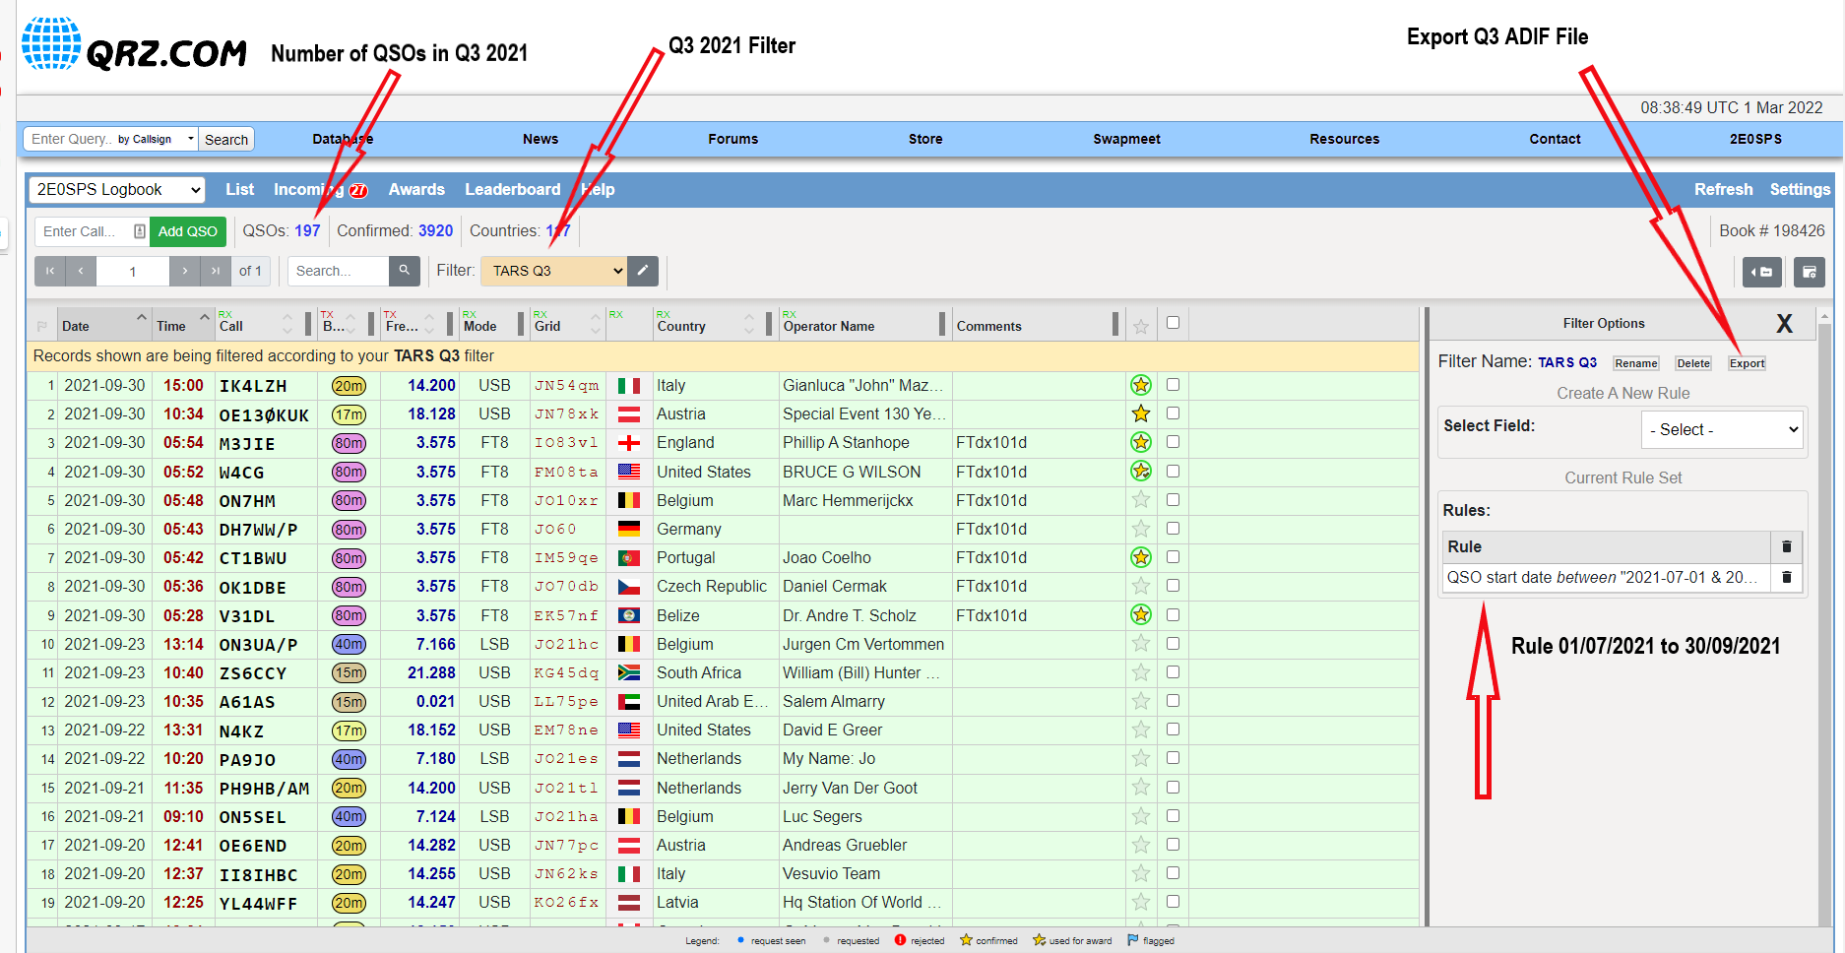
Part1 – QRZ Logbook Filters

Slide 14
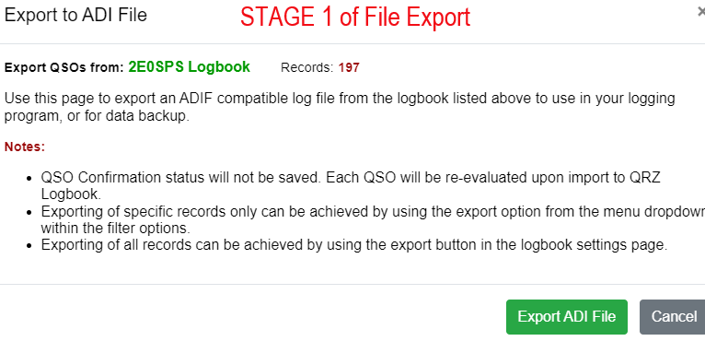
Part1 – QRZ Logbook ADIF File Export

Slide 15
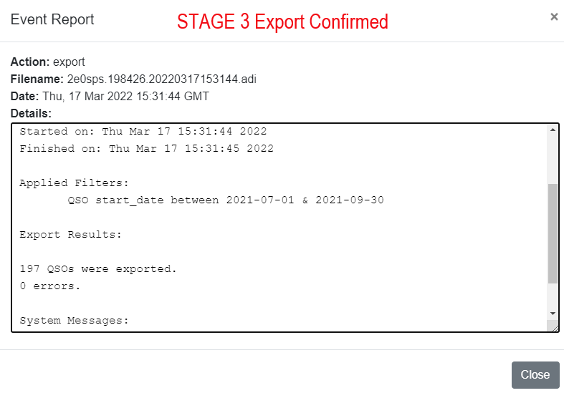
Part1 – QRZ Logbook ADIF File Export

Slide 16
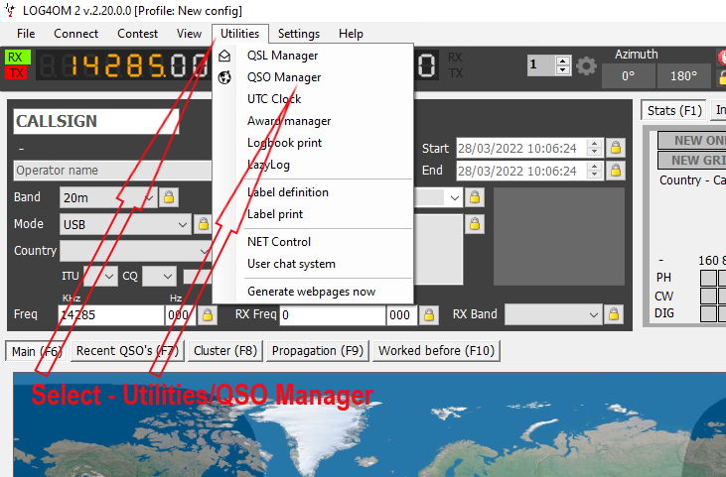
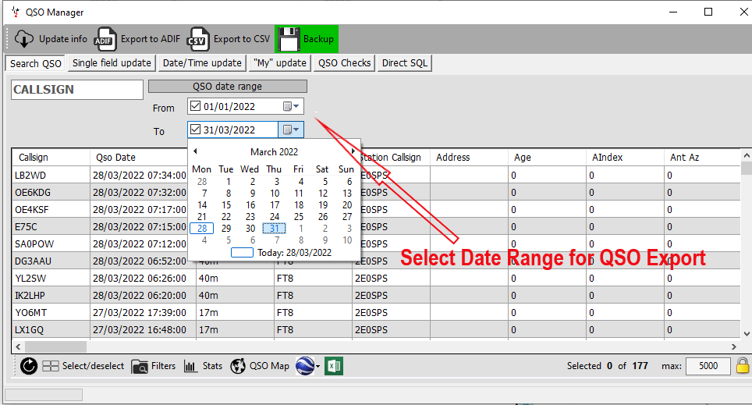
Part 2 – Log4OM .adi File Export
Export - Stage 1
Export - Stage 2

Slide 17
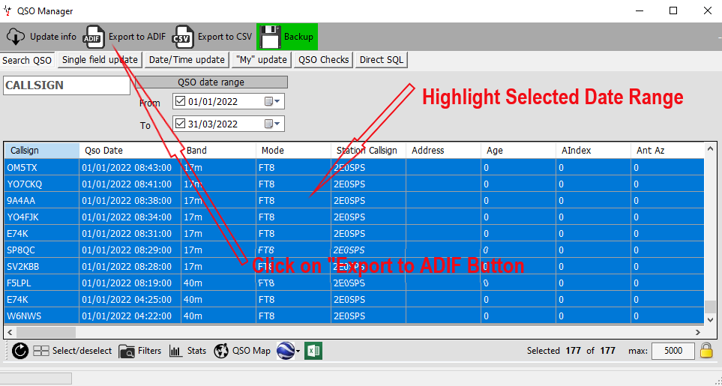
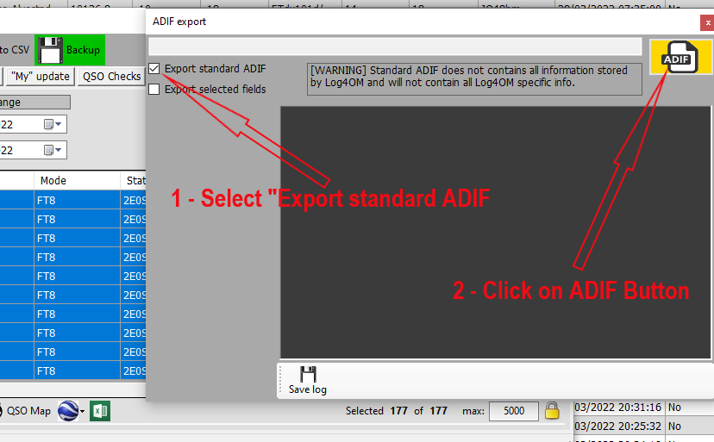
Part 2 – Log4OM .adi File Export
Export - Stage 3
Export - Stage 4

Slide 18
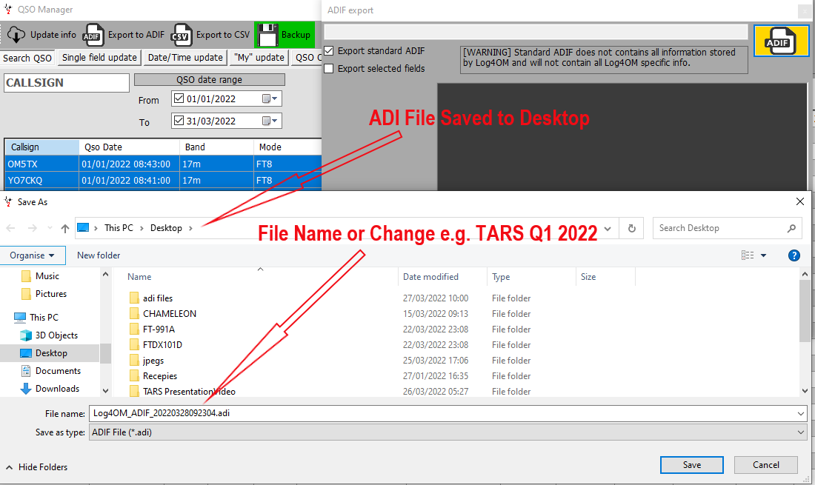
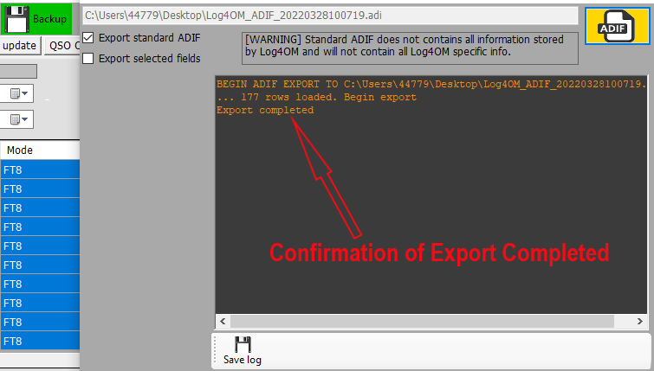
Part 2 – Log4OM .adi File Export
Export - Stage 3
Export - Stage 3

Slide 19
Part 3 – TARS Robot Wrap up
Any Final Questions
Workshop Parts 1 to 3 ?
Help with Setup bring your laptop

Slide 21
Part 3 TARS Contests January1st to December 31st
THE SHARON WALKER FOUNDATION MEMORIAL CUP
All Foundation License Holders (with no other License Held
THE G3LHJ FOUNDATION CUP
All Foundation License Holders (with no other License Held
THE HF DX CHALLENGE
Any member holding an INTERMEDIATE (2E0) licence
TARS 30 AWARD
All Licensed members
THE TARS VHF TRANSMITTING CUP
All Licensed members
THE SHARON WALKER HF MEMORIAL CUP (RTTY/AMTOR MODE)
All Licensed Members
THE G3UFZ ATV Trophy
All Licensed members
THE G8UUT MEMORIAL CUP - 50Mhz
All licensed members
THE G3WTV TARS ACTIVITY TROPHY
All Licensed Members
THE G4LZD QRP CUP
All Licensed members
THE 28MHz TRANSMITTING CUP
All Licensed members
THE W8HJ TROPHY
All Licensed members
WESTERN LF ROSE BOWL
All Licensed members
THE G2CWR MEMORIAL CUP - WARC BANDS
All Licensed members
THE HF SSB RESTRICTED TRANSMITTING AWARD THE HF CW RESTRICTED TRANSMITTING AWARD
All Licensed members
THE PSK31/DATA MODE TRANSMISSION AWARD
All Licensed members
THE SILENT KEY CUP (Prefixes)
All Licensed members

