Slide 1
Introduction to Electronic QSO Logging Recap
Part 1 - QRZ.com Introduction – 18th March 2022
Part 2 - Log4OM logging program introduction - 1st April 2022
Log4OM to QRZ.com QSO Integration
Part 3 - TARS Robot and how to submit logs for TARS Contest – 29th April 2022
Part 4 - Minos Contest logging program introduction for RSGB VHF & UHF Contests -TBD
Part 5 - N1MM contest logging program introduction – TBD
Part 6 - Contest logging hands on practical demonstration - TBD
John Bogdaniec 2E0SPS

Slide 2
Part 2 Log4OM Logging Program Introduction and Log4OM to QRZ.com QSO Integration
John Bogdaniec 2E0SPS

Slide 3
Part 2 - Log4OM
Log4OM Installation
Initial Basic Set-Up
Creating the Database
Assigning Correct COM Port
OmniRig Installation and Setup
Connecting CAT
Setting up automatic station look-up/map position
Log4OM to QRZ.com QSO Integration
ADIF File Import
ADIF File Export
Resources and what's not covered

Slide 4
Part 2 – Log4OM Installation
Download and install virtual COM drivers for your radio
Required for RIG Control
Download and install Log4OM @ www.log4om.com/download
unzip (Unpack) the compressed download file to a convenient location
Run the installer exe file
Accept licence agreement
DO NOT Tick Omni-Rig Installation
Install v1.2 Omni-Rig @ DX Atlas: Amateur Radio software
Tick Create desktop shortcut

Slide 5
Part 2 - Initial Basic Set-Up
1 - Double click on desktop shortcut. On initial start-up you will be presented with window below.
2 - All information circled must be completed to enable Log4OM to select correct band-plans, maps, modes etc
3 - Click “Save and Apply”

Slide 6
Part 2 – Creating the Database
1 - Having clicked “Save and Apply” to Initial Set-Up, program will open new tab for creating new database below
2 - Click on ”New” circled

Slide 7
Part 2 – Creating the Database (cont)
1 – Navigate to location for storage of data (location can be “Cloud Storage”)
2 – Enter a “File Name” e.g. TARS Demo
3 – Click “Save” followed by “OK” them “Save and Apply”
Note: QSO’s can’t be recorded or uploaded until database has been created

Slide 8
Part 2 Assigning Correct COM Port for OmniRig/CAT Control
Example for Yaesu FTDX 101
Correct COM port selection for CAT communication
1 - Ensure you install driver before connecting USB cable
2 - COM Port number will vary on your computer
Check your Radio Documentation for Port Assignment
Note – DO NOT Connect your USB Cable from PC to Radio Until Drivers have Been Installed

Slide 9
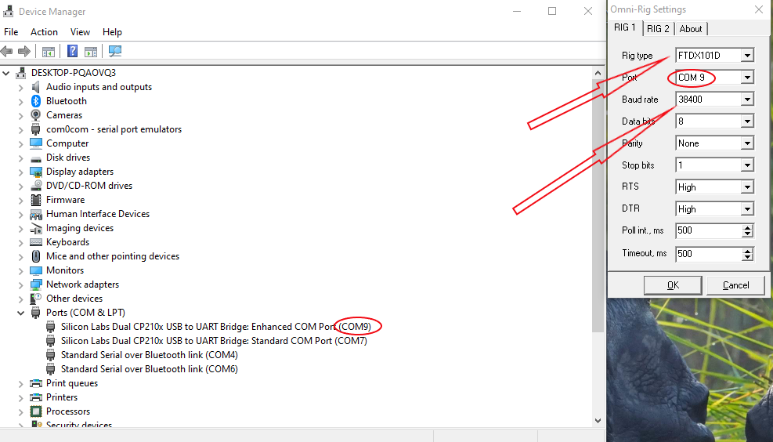
Part 2 - OmniRig Installation and Set-Up
If OmniRig was not installed during Log4OM install, you can install @ DX Atlas: Amateur Radio software
Then re-start Log4OM
Devices Manager
OmniRig
OmniRig Set-Up
1 - Set correct COM Port in OmniRig Assigned
in Devices Manager (circled)
2 - Select you Radio and appropriate Baud Rate
from drop down
3 - Click “OK” to save settings

Slide 10
Part 2 - Log4OM Recap
Log4OM Installation
Initial Basic Set-Up
Creating the Database
ADIF File Import
Assigning Correct COM Port
Omni-Rig Installation and Setup
Connecting CAT
Setting up automatic station look-up/map position
Log4OM to QRZ.com QSO Integration
ADIF File Import
ADIF File Export
Resources and what's not covered

Slide 11
Part 2 - Connecting CAT
To select the CAT Interface, click on 'Settings/Program configuration
1 - Select “CAT interface” from left
hand menu
2 - Select Omnirig from drop down
and tick “CAT auto-start” check box
3 – Click “Save and Apply” to save settings

Slide 12
Part 2 Automatic station lookup/map position
To select the “Station Lookup” click on 'Settings/Program configuration
1 - Select “Info Providers” from left
hand menu
2 - Select QRZ.com as Primary Source
3 - Enter your callsign and QRZ password
4 - Click “Save and Apply” to save settings

Slide 13
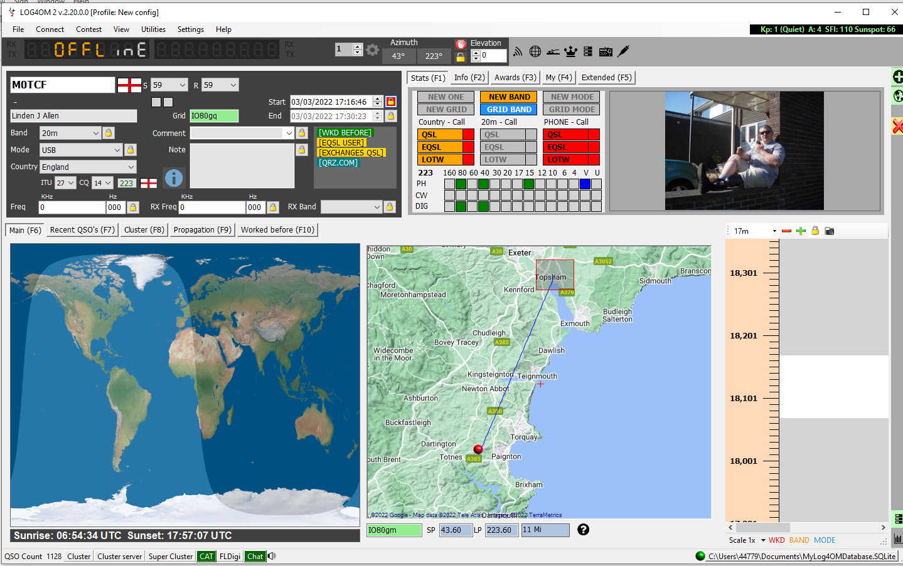
Part 2 Automatic station lookup/map position (cont)

Slide 14
Log4OM QSO integration to QRZ.com
To select the External Services, click on 'Settings/Program configuration
1 - Select “External Services” from left hand menu
2 - Select QRZ.com as external services provider
3 - Enter your API KEY
4 - Check Automatic upload on new QSO
5 - Click “Save and Apply” to save settings
Note – Only Available if Using Paid QRZ.com

Slide 15
Part 2 – ADIF File Import
1 - On main program screen Click “File/Import ADIF” to open window below
2 - Click “Load Button” and navigate to select ADIF File and click “Open”
3 - Select “Apply Quality Check Corrections” from drop down (corrects any DXCC errors)
4 - Click “Import Button” and wait until import is completed
5 - “Save Log” button will save copy of log file
Note
Checking box “Drop Current Database and Load ADIF”
will replace existing data by incoming ADIF File
Leaving the “Drop Current Database and Load ADIF”
unchecked will merge imported data with existing data
“Duplicates threshold' allows the user to set a margin for
matching the QSO start times +/- nn seconds up to 60 seconds
to avoid causing duplicates due to timing errors. This is a function
is used when importing QSO from other sources that do not have
a time resolution to seconds (e.g. QRZ.COM exports) and it is
required to merge the QRZ log with the Log4OM logbook

Slide 16
Part 2 – ADIF File Import (Cont)
Notes:
Illegal Suffixes: Strange suffixes may cause some errors during import and cause an incorrect DXCC number and country name to be applied
Examples: A station incorrectly using /LH as a suffix intending to signify a 'Light House' will be interpreted as a Norwegian station and recorded as such! A station incorrectly using /PM as a suffix intending to signify 'Pedestrian Mobile' will be interpreted as an Indonesian station and recorded as such /MM (Maritime Mobile) and /AM (Aeronautical Mobile) will be saved without a country name or DXCC due to the locations being outside any entity. /P (Portable), /A (Alternative location in some countries), /QRP, /QRPP and /M (Mobile) will have no impact on the import and the country will be identified by the normal call sign prefix. Call checking also includes checking the valid dates of special calls and DXPeditions to ensure further accuracy.

Slide 17
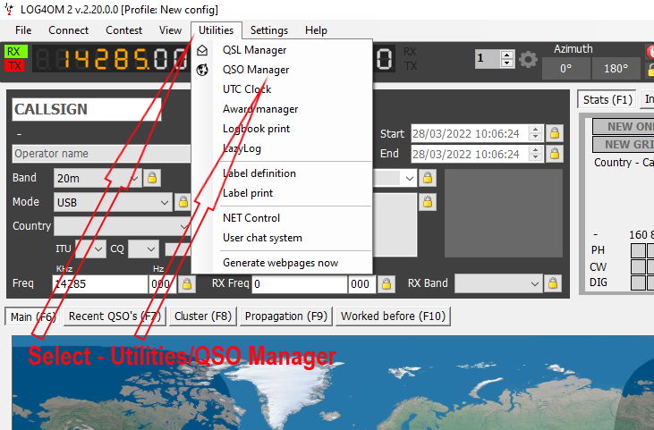
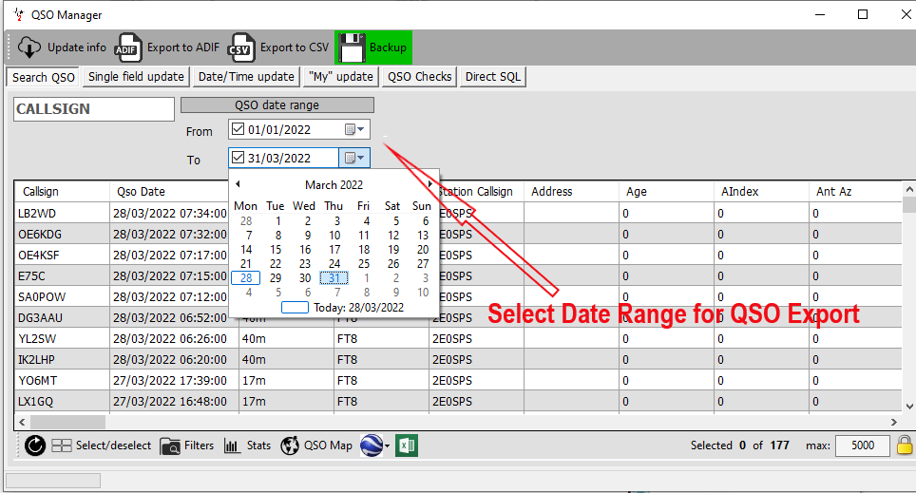
Part 2 – ADIF File Export
Export - Stage 1
Export - Stage 2

Slide 18
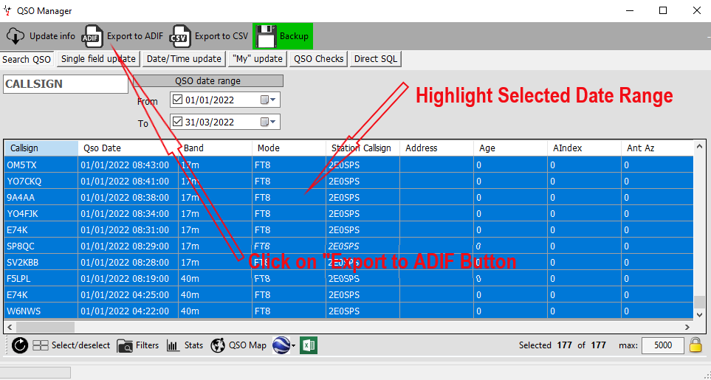
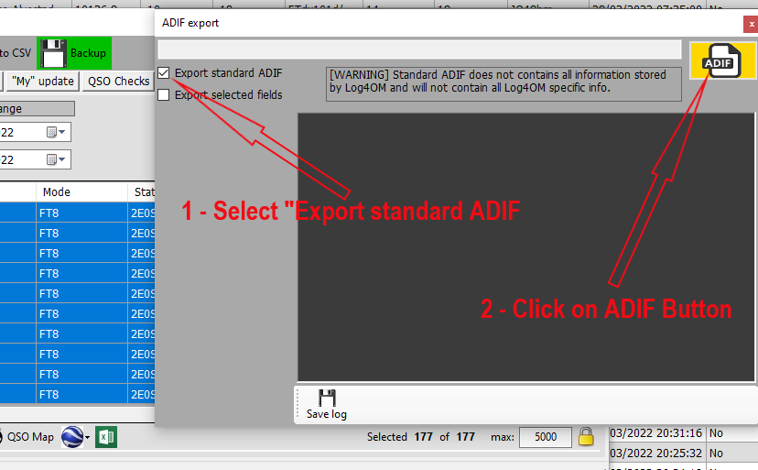
Part 2 – ADIF File Export
Export - Stage 3
Export - Stage 4

Slide 19
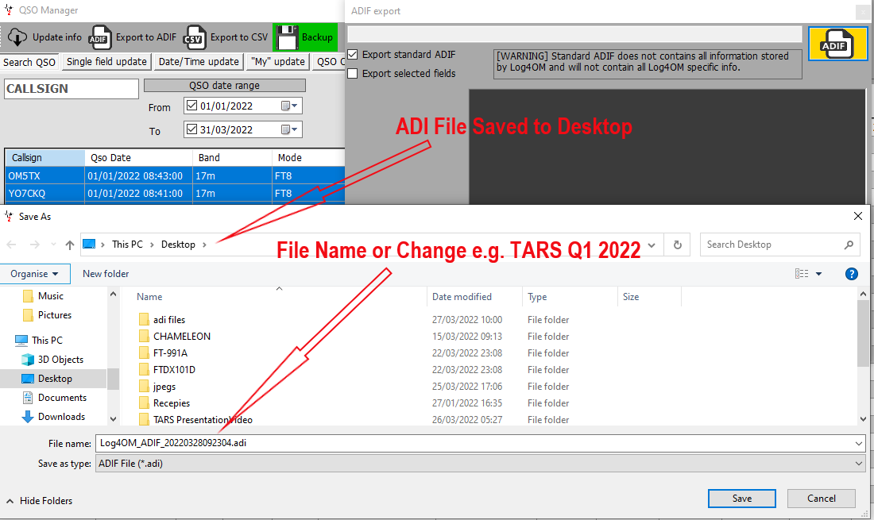
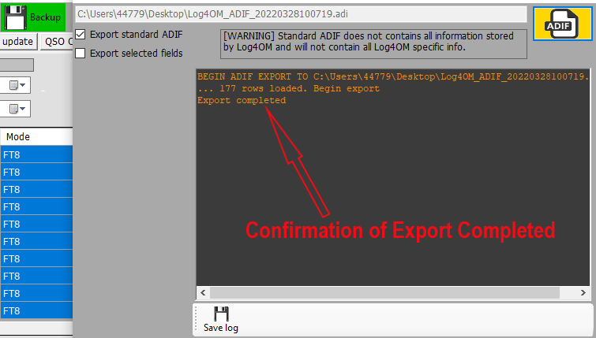
Part 2 – ADIF File Export
Export - Stage 3
Export - Stage 3

Slide 20
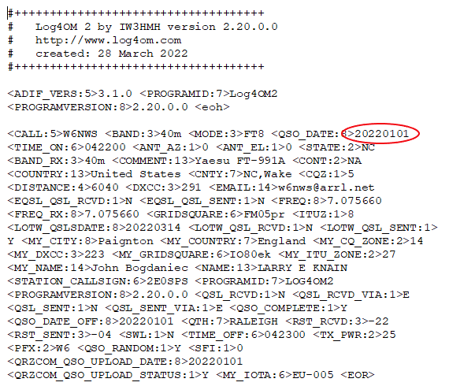
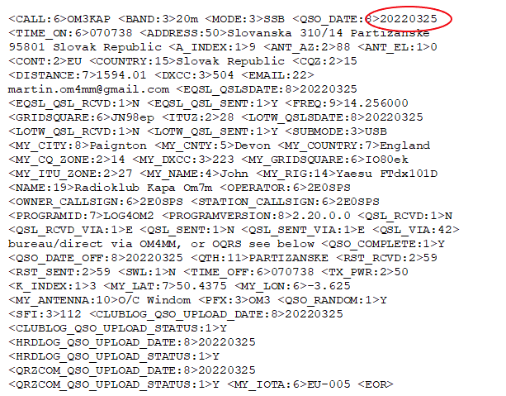
Part 2 – ADIF File Export
First QSO in Date Range
Last QSO in Date Range

Slide 21
Resources and what's not covered
Resources
Log4OM Quick Start Guide - Quick_Start_Guide_EN.pdf (log4om.com)
Log4OM User Guide - Log4OMNG_ENU.pdf
Log4OM Forum - Log4OM - Index page
Log4OM YouTube Channel - (81) Terry Genes – YouTube
What’s NOT covered in Log4OM
Cluster settings Telnet Cluster Contest mode Statistics Awards Solar data Propagation | QSL manager QSO Manager Awards manager Label definition and print NET Control User chat system Rotator control L

