Slide 1
Introduction to Electronic QSO Logging
Part 1 - QRZ.com Introduction – 18th March 2022
Part 2 - LOG4OM logging program introduction – 1st April 2022
LOG4OM to QRZ.com QSO Integration
Part 3 - TARS Robot Introduction & how to submit logs for TARS Contest Awards Program - TBD
Part 4 - Minos Contest logging program introduction for RSGB VHF & UHF Contests - TBD
Part 5 - N1MM contest logging program introduction - TBD
Part 6 - Contest logging hands on practical demonstration - TBD
John Bogdaniec 2E0SPS

Slide 2
Part 1 – QRZ.com
John Bogdaniec 2E0SPS

Slide 3
Part 1 – What is QRZ.com
It’s a “phone book” for radio amateurs
Licenced amateurs around the world will have an entry in QRZ.com
Some have basic information, others have photos, online logs, their station details and life stories

Slide 4
Part 1 – QRZ.com Logbook
How do I get my callsign listed
Free version with limitations
Subscription provides additional benefits
Subscription Costs
Lets take a look at typical QRZ.com page
QRZ Logbook QSO Confirmations
QRZ Logbook Filters
QRZ Logbook ADI File Export

Slide 5
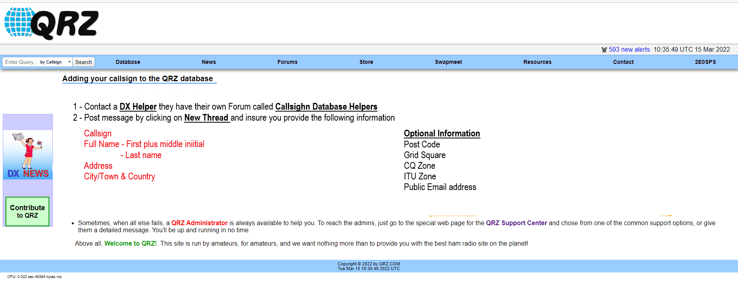
Part 1 – How do I get my callsign listed
Lets follow this link for Callsign Database Helpers
https://forums.qrz.com/index.php?forums/add-my-call-sign-to-qrz-database-helpers-forum.121/

Slide 6
Part 1 – Free QRZ.com Logbook
QRZ logbook available to QRZ registered users
Enable users to log their on-air contacts (OSO’s) with worked stations
But NO Rig Control
Ability to access your logs from any internet connected computer
Either or both parties of a QSO may enter a record into QRZ database for awards
Periodically system compares users records and automatically confirms matching records
Confirmed records are automatically applied to operating awards
Lacking a confirmation, a user may choose to forward a confirmation request to another QRZ Logbook user
Records entered manually or imported from ADIF files
Users have control of logbook
Add
Delete
Edit

Slide 7
Part 1 – Subscription based QRZ.com
Ability to create and maintain multiple logbooks for multiple callsigns
2E0SPS/M
2E0SPS/P
Wide range of Display Options that allow you to customize the Logbook user interface
Designate "guest" operators who can assist in multi-operator scenarios
ADIF export capabilities
QRZ logbook API integration allows 3rd party applications access to your log records by using the API Key

Slide 8
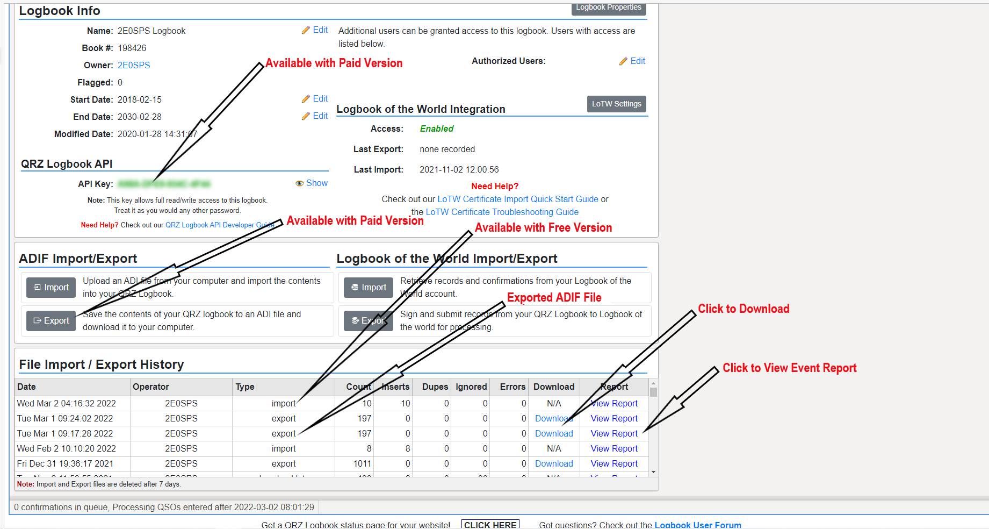
Part1 – Paid QRZ Logbook Benefits

Slide 9
Part 1 – Subscriptions

Slide 10
Part 1 – QRZ.com (What’s Been Covered)
What is QRZ.com
It’s a “phone book” for radio amateurs
Licenced amateurs around the world will have an entry in QRZ.com
Some have basic information, others have photos, online logs, their station details and life stories
QRZ.com Logbook
How do I get my callsign listed
Free version with limitations
Subscription provides additional benefits
Subscription Costs
Lets take a look at typical QRZ.com page
QRZ Logbook QSO Confirmations
QRZ Logbook Filters
QRZ Logbook ADIF File Export

Slide 11
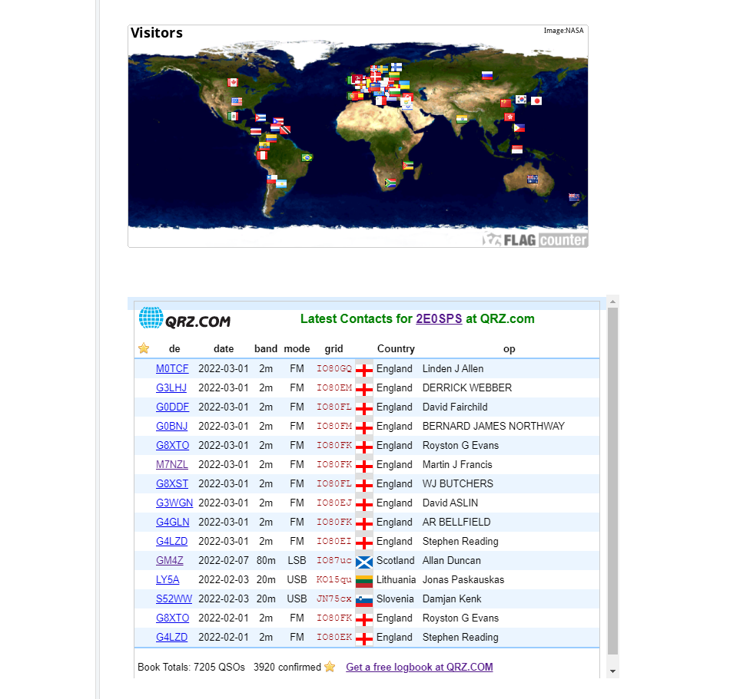
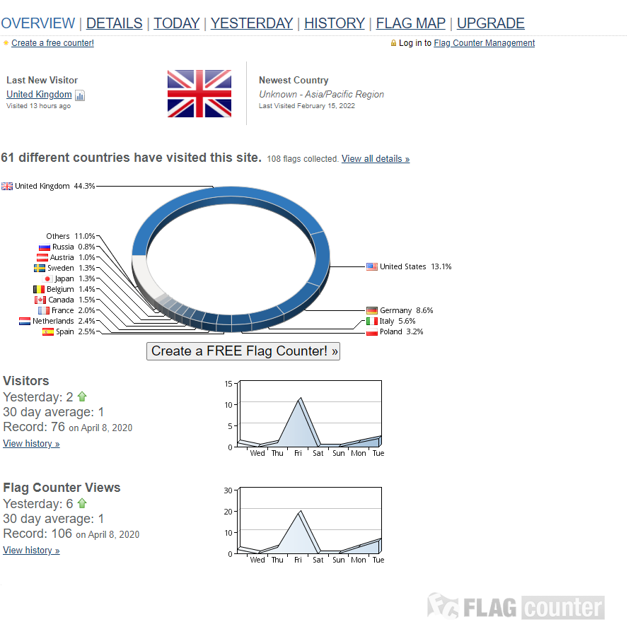
Part1 – QRZ Logbook (2E0SPS)

Slide 12
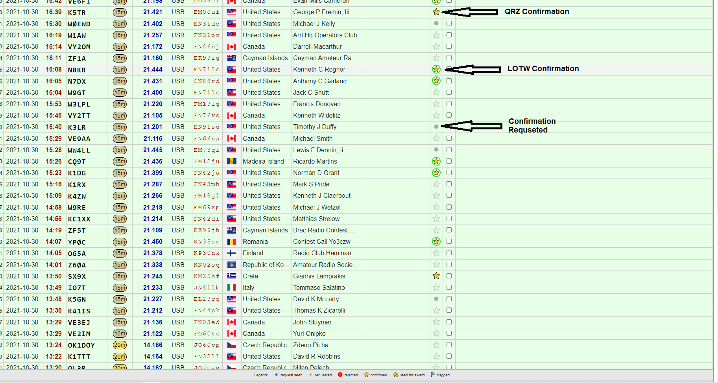
Part1 – QRZ Logbook QSO Confirmation

Slide 13
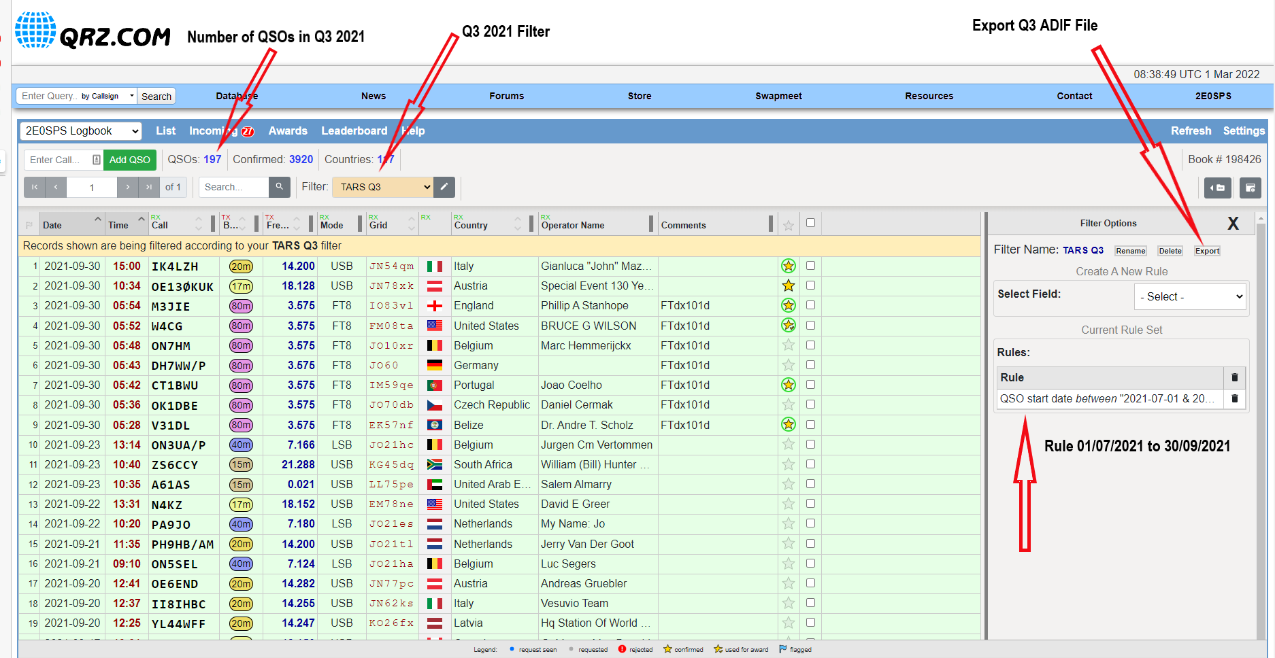
Part1 – QRZ Logbook Filters

Slide 14
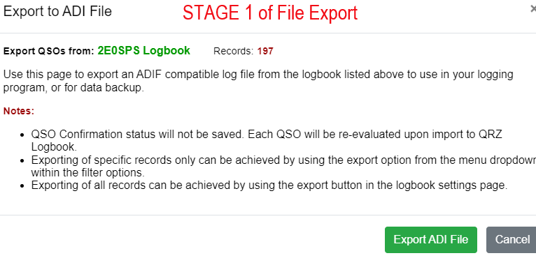
Part1 – QRZ Logbook ADIF File Export

Slide 15
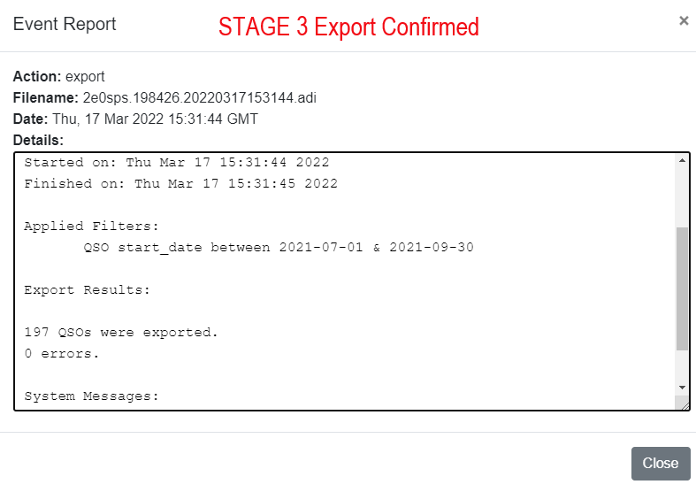
Part1 – QRZ Logbook ADIF File Export

Slide 16
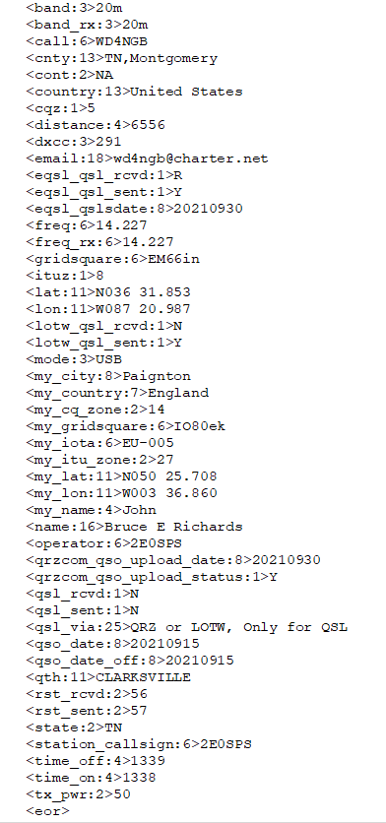
Typical Exported ADIF QSO
Worked Station Details
My Station Details

Slide 17
Live QRZ.com Page
Let’s Take a Look at a Live QRZ Page
and some settings
2E0SPS - Callsign Lookup by QRZ Ham Radio
Mike M7MYK will also show us how to wright a Filter for TARS Q1 2022 QSOs Contests Awards

Slide 18
That concludes Part 1 – QRZ.com Any final Questions? Presentation will be uploaded to TARS Website Thank You for your Participation

