Slide 1
Adding brandmeister api
TARS – M0CHE

Slide 2
Before you start…
Built Hot-spot.

Slide 3
What is this?
Hopefully the previous presentation has helped you build your hotspot and you have had a few contacts.
This presentation will show you how to add Brandmeister API to the Pi-Star.

Slide 4
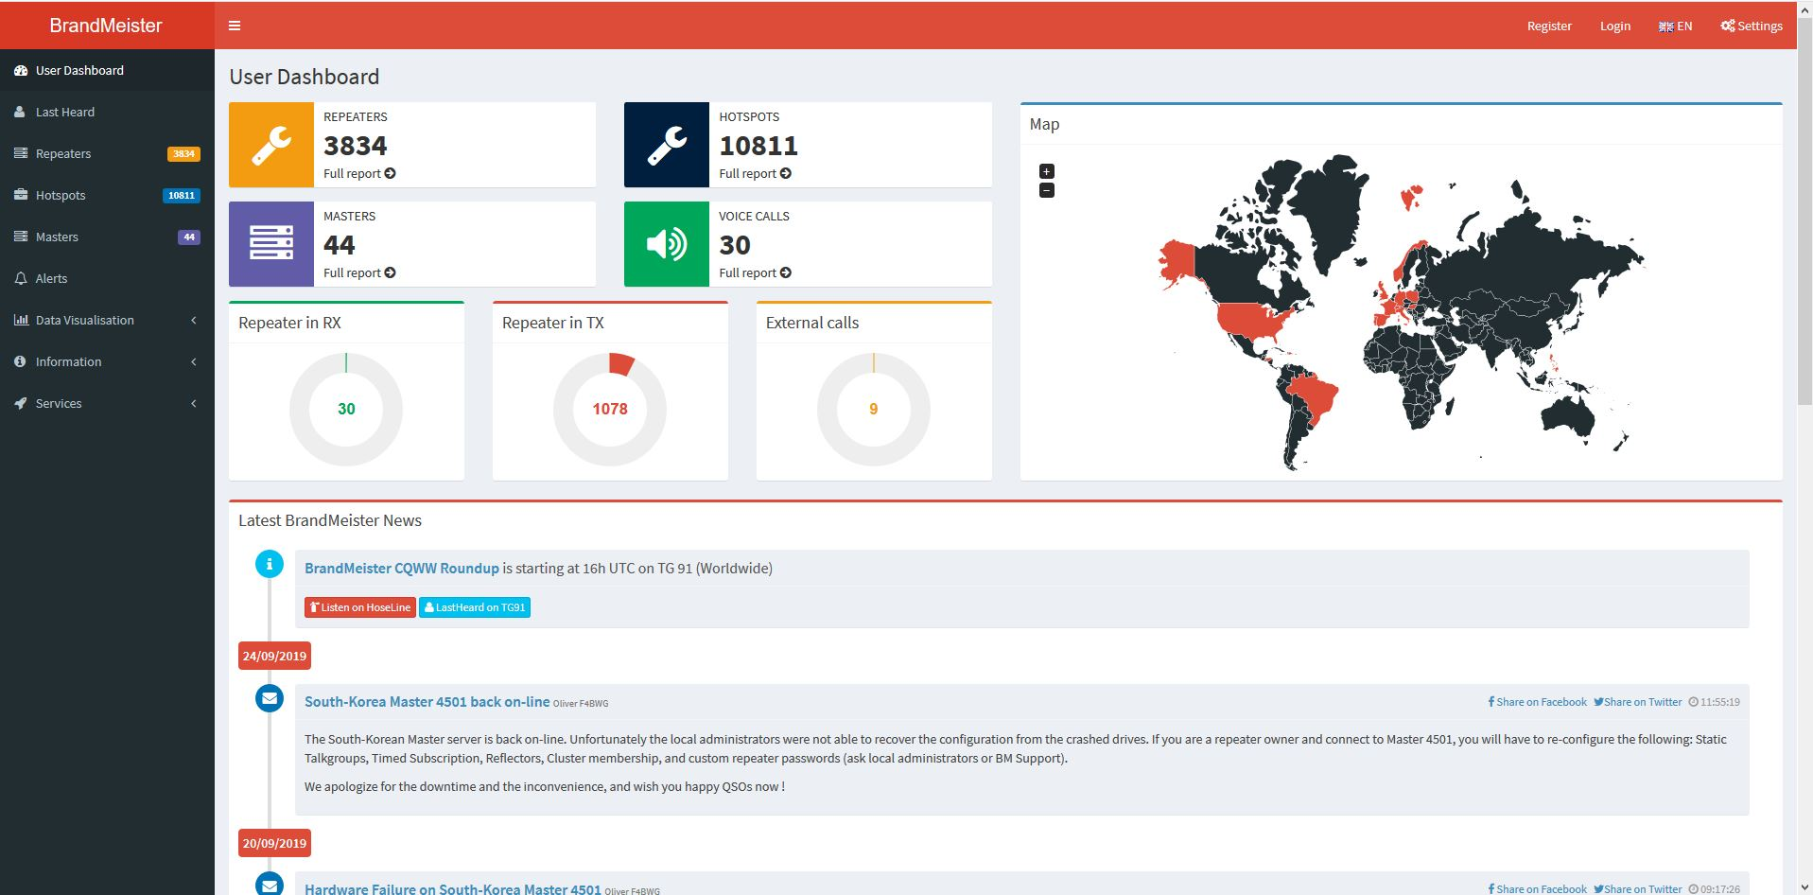
registration
Before you can get the API key you must register with Bradmeister.
Its simple enough..
Go to https://brandmeister.network/
Choose register…

Slide 5
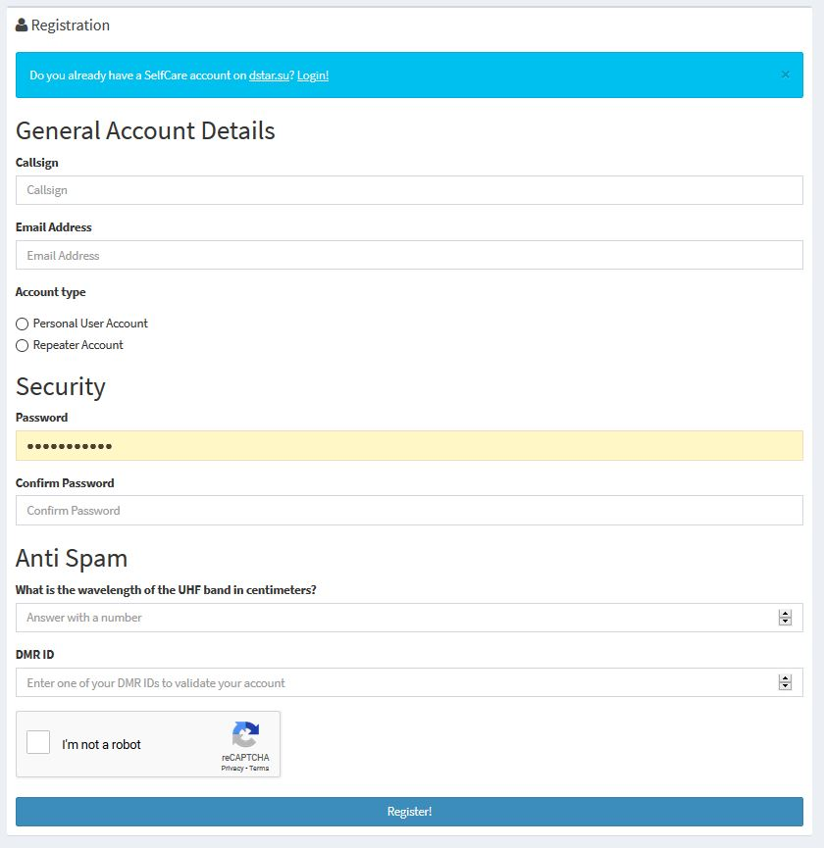
registration
Complete the registration form:
There is one question to complete…
Im sure you know the answer!

Slide 6
login
Now you have registered you can login:

Slide 7
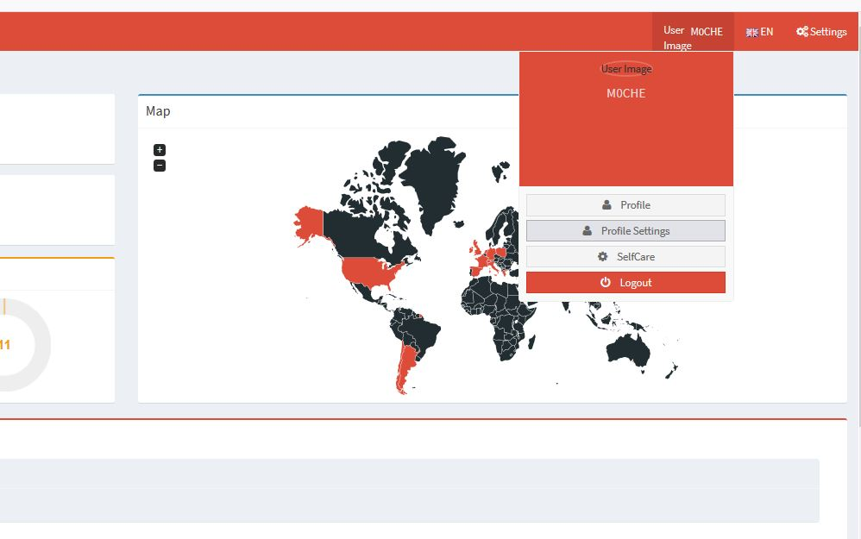
Once logged in
Now you have logged in click on
Your call sign and choose:
Profile settings

Slide 8
Profile settings
Now choose API Keys

Slide 9
Profile settings
Now choose Add:

Slide 10
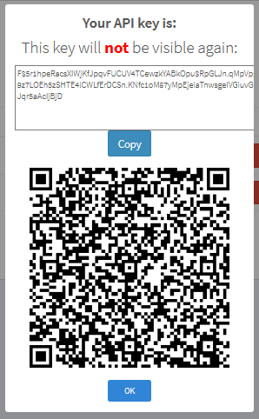
COPy the api key
Now you have named it the key will be built and you will see this:
Copy the gobbledygook from the top.
This is your API key to paste into Pi-Star.
Make a copy. You won t see it again!

Slide 11
Configure pi-star

Slide 12
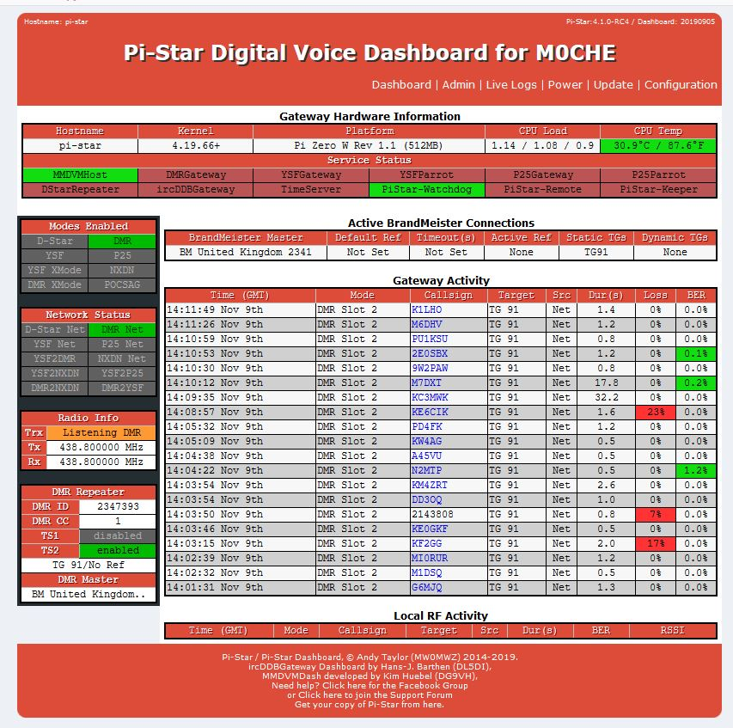
Configure pi-star
Ok, you have an API key.
What do we do with it now?
We have to install the key in to Pi-Star.
It will look something like this before the
key is installed.

Slide 13
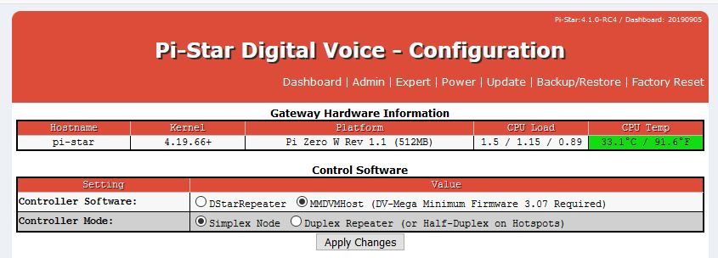
Configure pi-star
Click on Configuration and this will appear:

Slide 14
Configure pi-star
Click on Expert:
Heed the warning!

Slide 15
Configure pi-star
Add your key.
You know the one
you saved…
Apply!

Slide 16
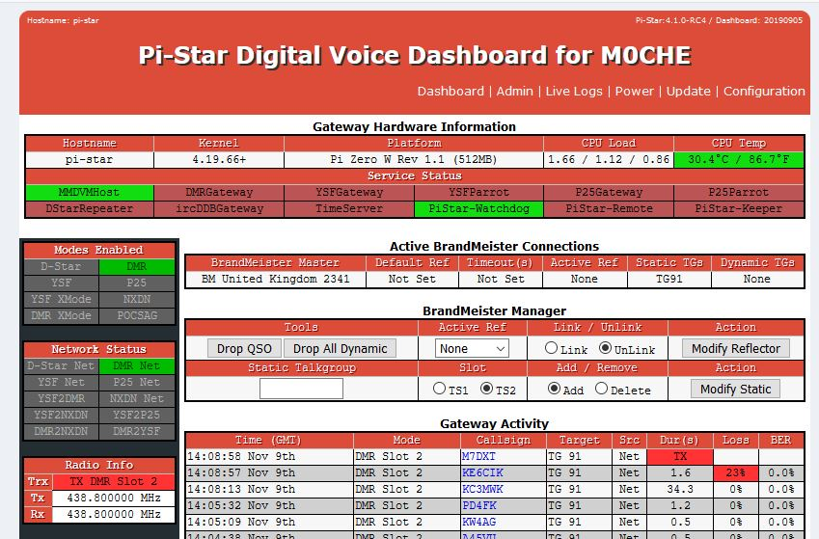
Configure pi-star
Move back to the Admin
Screen.
Things will look a bit
different.

Slide 17
Enjoy your hot-spot!
That’s it done. You have installed the API key to Bradmeister.
You can now set the talk group etc through Pi-Star.
Enjoy!

