Slide 1
Building your Hot-spot
TARS – M0CHE

Slide 2
Before you start…
MMDVM Modem Board Kit.
Raspberry Pi ZERO W.
Micro SD card. At least 8Mb.
Pi-Star software image.
Win32Disk Imager software.
Wi-Fi Supplicant file.
Patience!

Slide 3
The mmdvm kit
The kits are readily available on eBay.

Slide 4
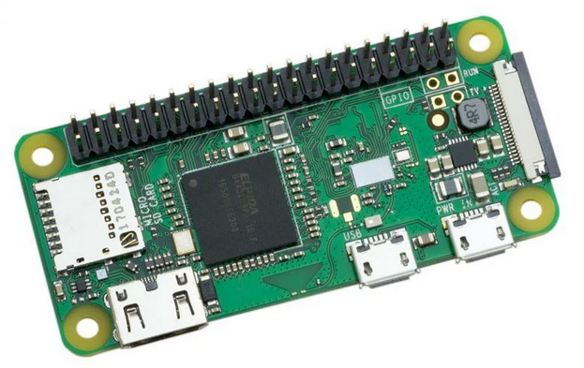
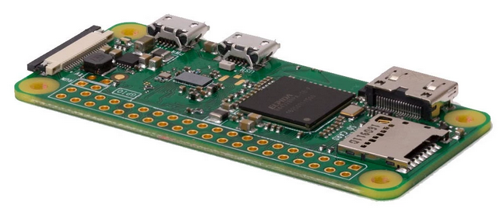
Raspberry pi zero w
The W is important!
It means it’s the Wireless version of the Pi Zero.
There are two versions available. With headers and without headers.
Its easier to get the full header version. You can also then use it for other projects

Slide 5
Micro sd card
For this to all work you will need a micro SD card to store the operating system and the Pi-Star software.
Cheap on Amazon. Search ‘micro SD 8Gb’.

Slide 6
Pi-star software image
Pi-Star is the software that gives us the magic.
It’s a browser based application that provides the encoding, decoding, configuration and monitoring of the hardware.
In the download section choose P-Star.
We will cover configuration later.

Slide 7
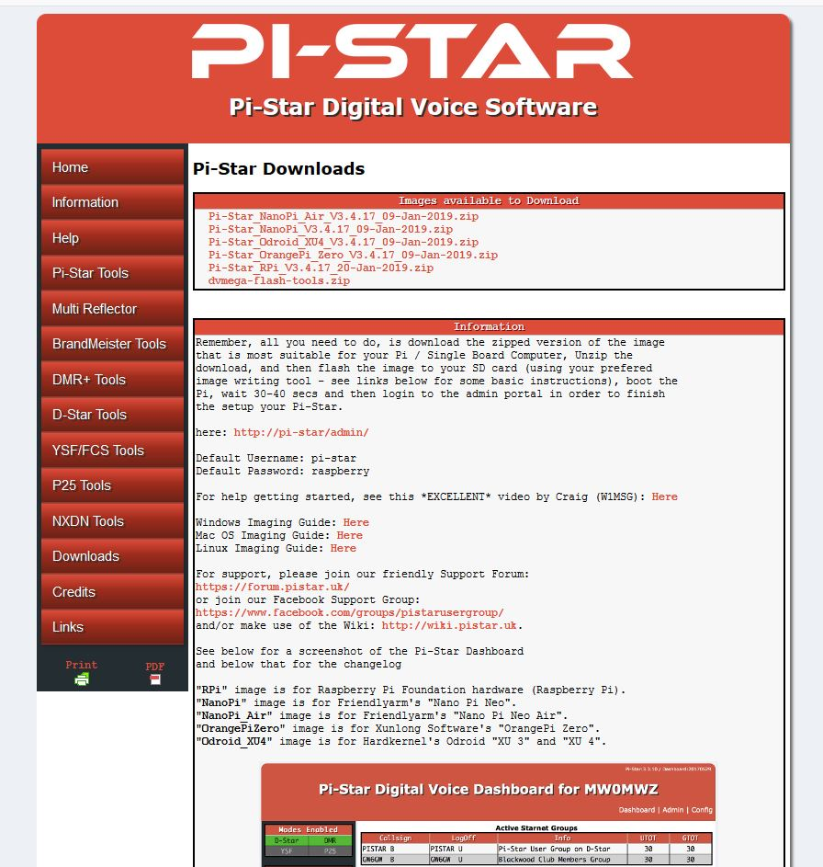
Pi-star software image
Choose the correct image to download:
Pi-Star_RPi_V3.4.17_20-Jan-2019.zip
Once downloaded, unzip to a folder
of your choice.

Slide 8
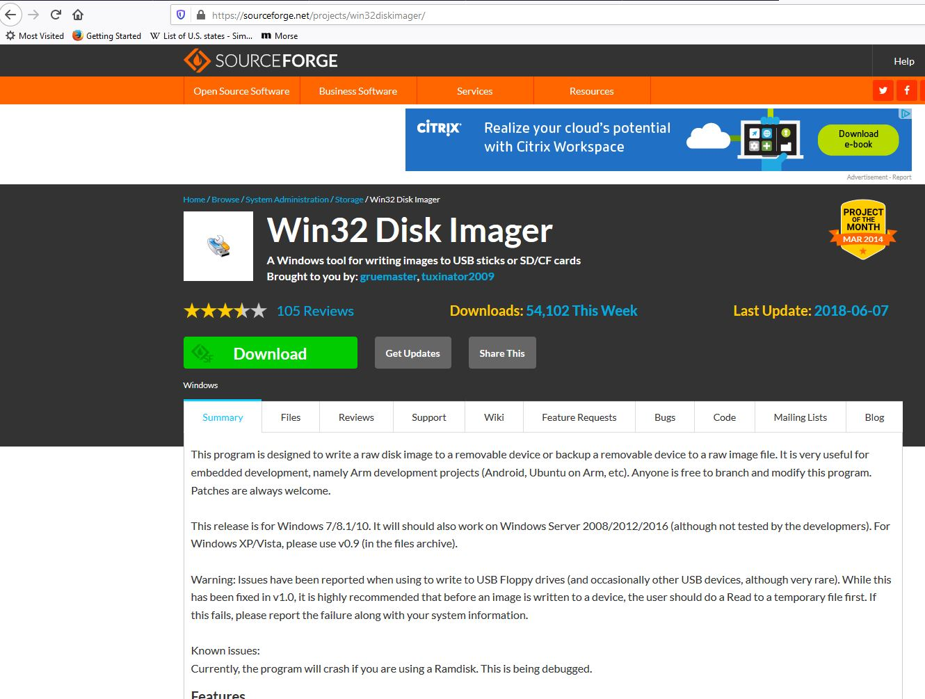
Win32disk image software
Download the free image writer and install.

Slide 9
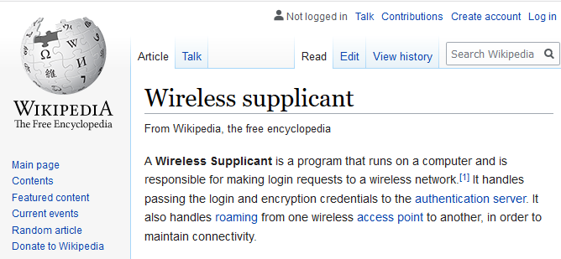
Wi-fi supplicant file
A what file?

Slide 10
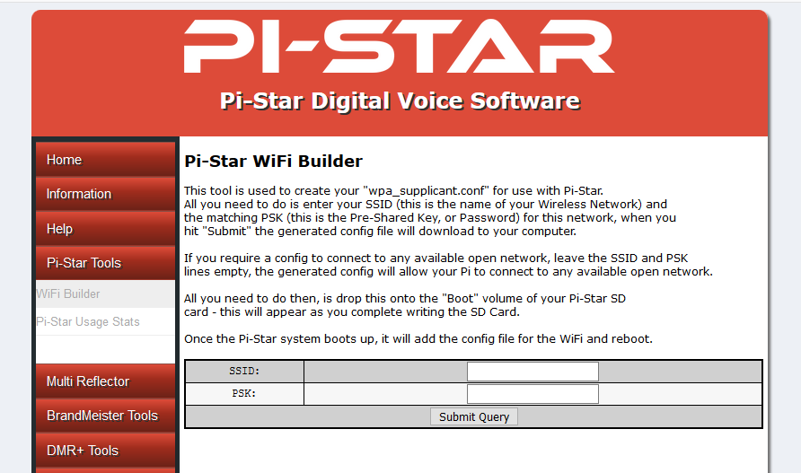
WI-fi supplicant file
DON’T PANIC!
There is a tool on the Pi-Star web site:
Enter your SSID.
Enter your Wi-Fi password.
Save the file on your computer.
You will need it later!

Slide 11
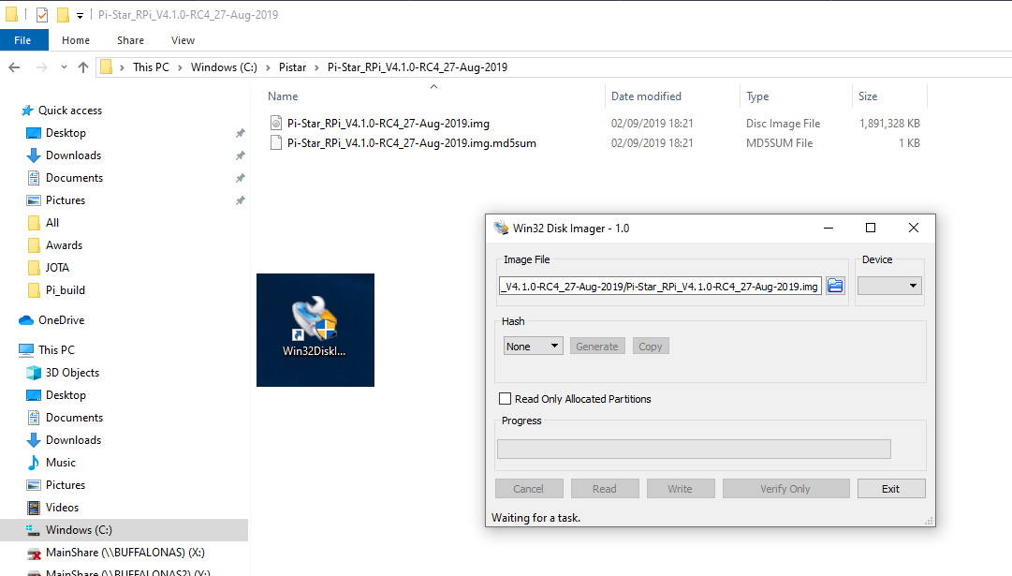
Writing the image
We downloaded and un-zipped the image file earlier.
Now open Win32DiskImager and choose the .img file. Ensure you choose your micro SD card drive letter!
If you overwrite your C:
drive, don’t complain to me!

Slide 12
Lets build!

Slide 13
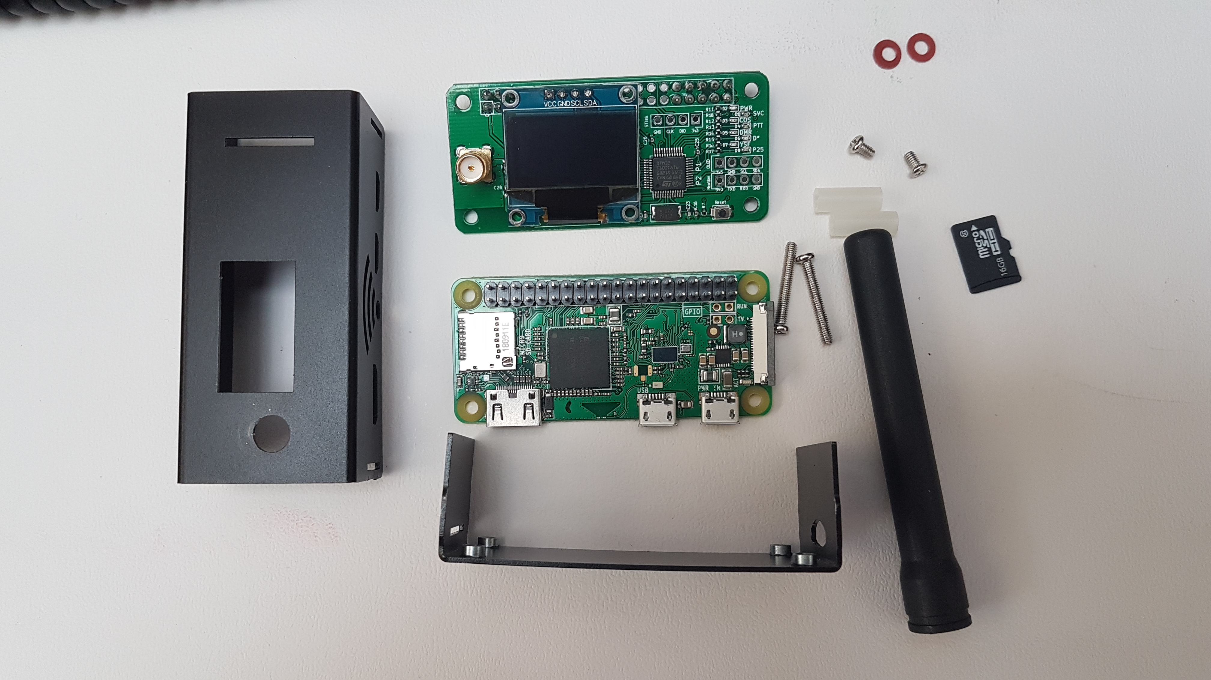
Putting it together
It’s a straight forward process to put the hardware together…
But there are one or two things to watch for.

Slide 14
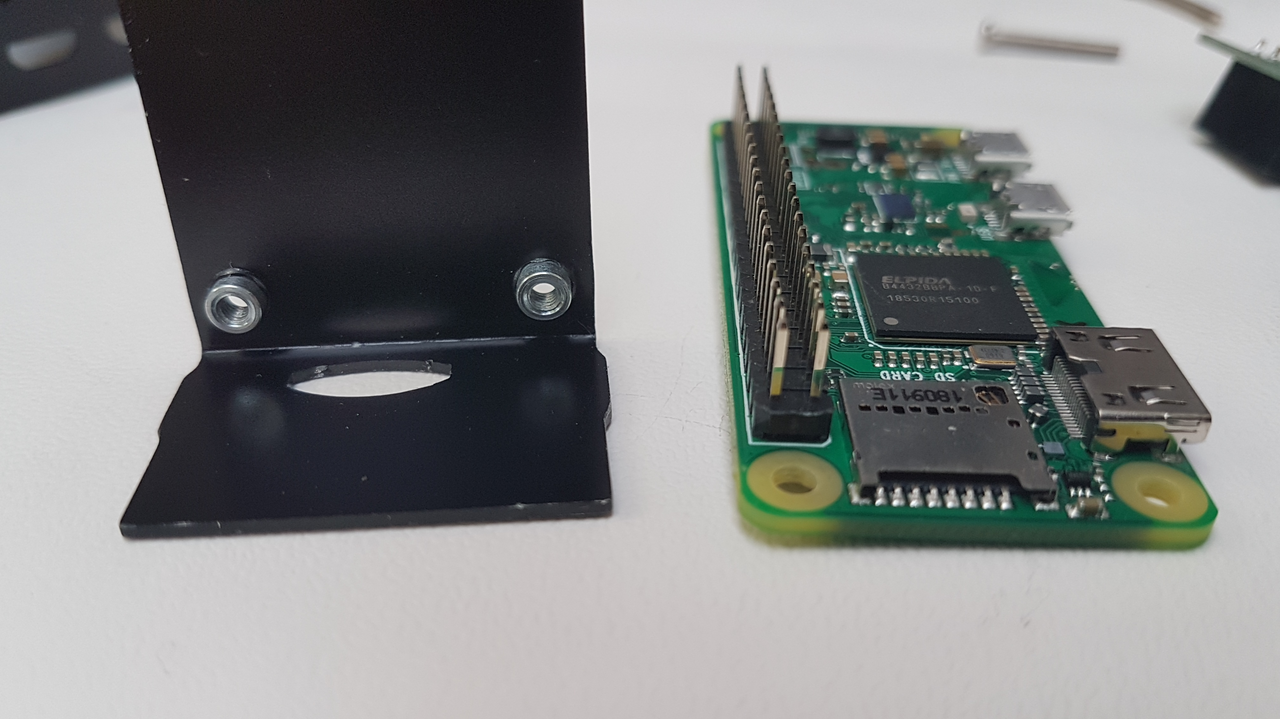
Putting it together
Correct orientation of the Pi Zero W.
The Pi Zero W will fit into the case both
Ways around. Get it the wrong way
around and you will not be able to insert
the micro SD card!
See the larger hole in the case?

Slide 15
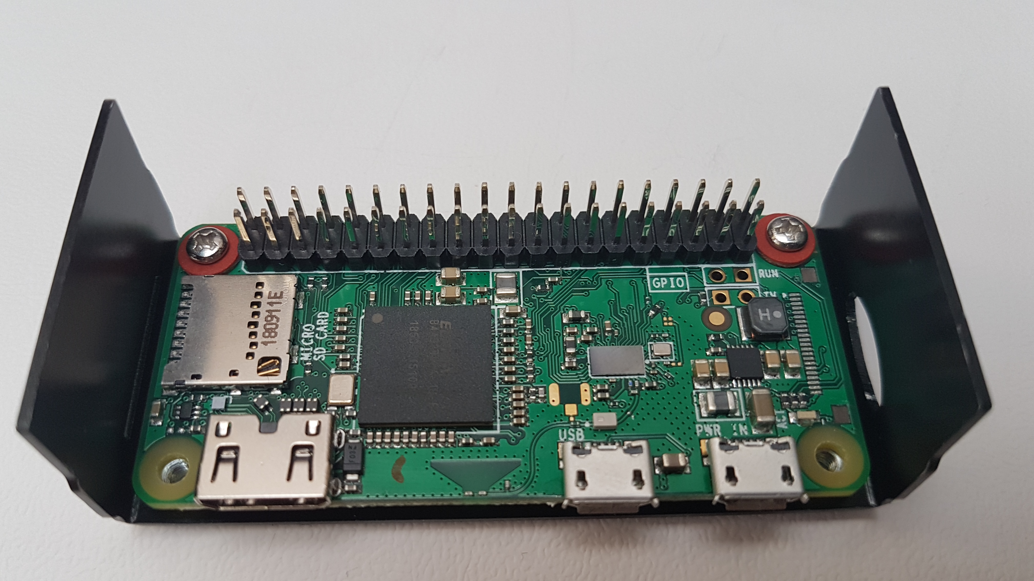
Putting it together
Unlike I did before I took this photo…
Also notice
The screws
Are on the
far side of
the power
input….

Slide 16
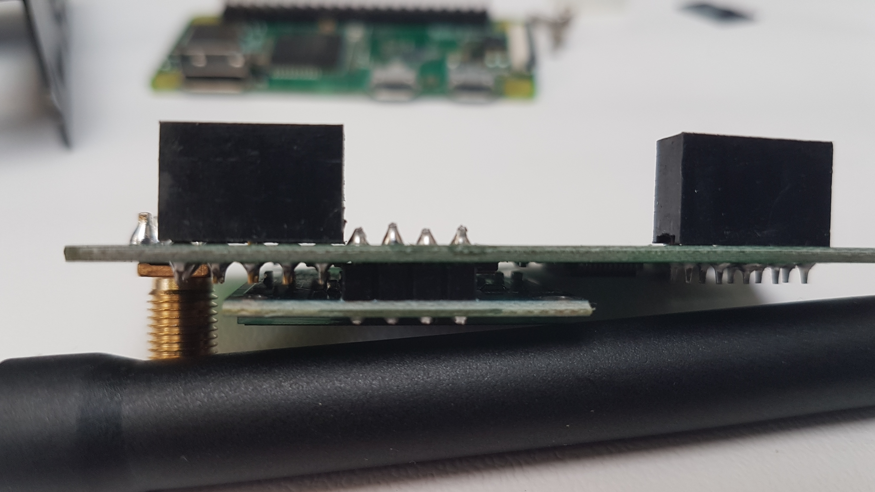
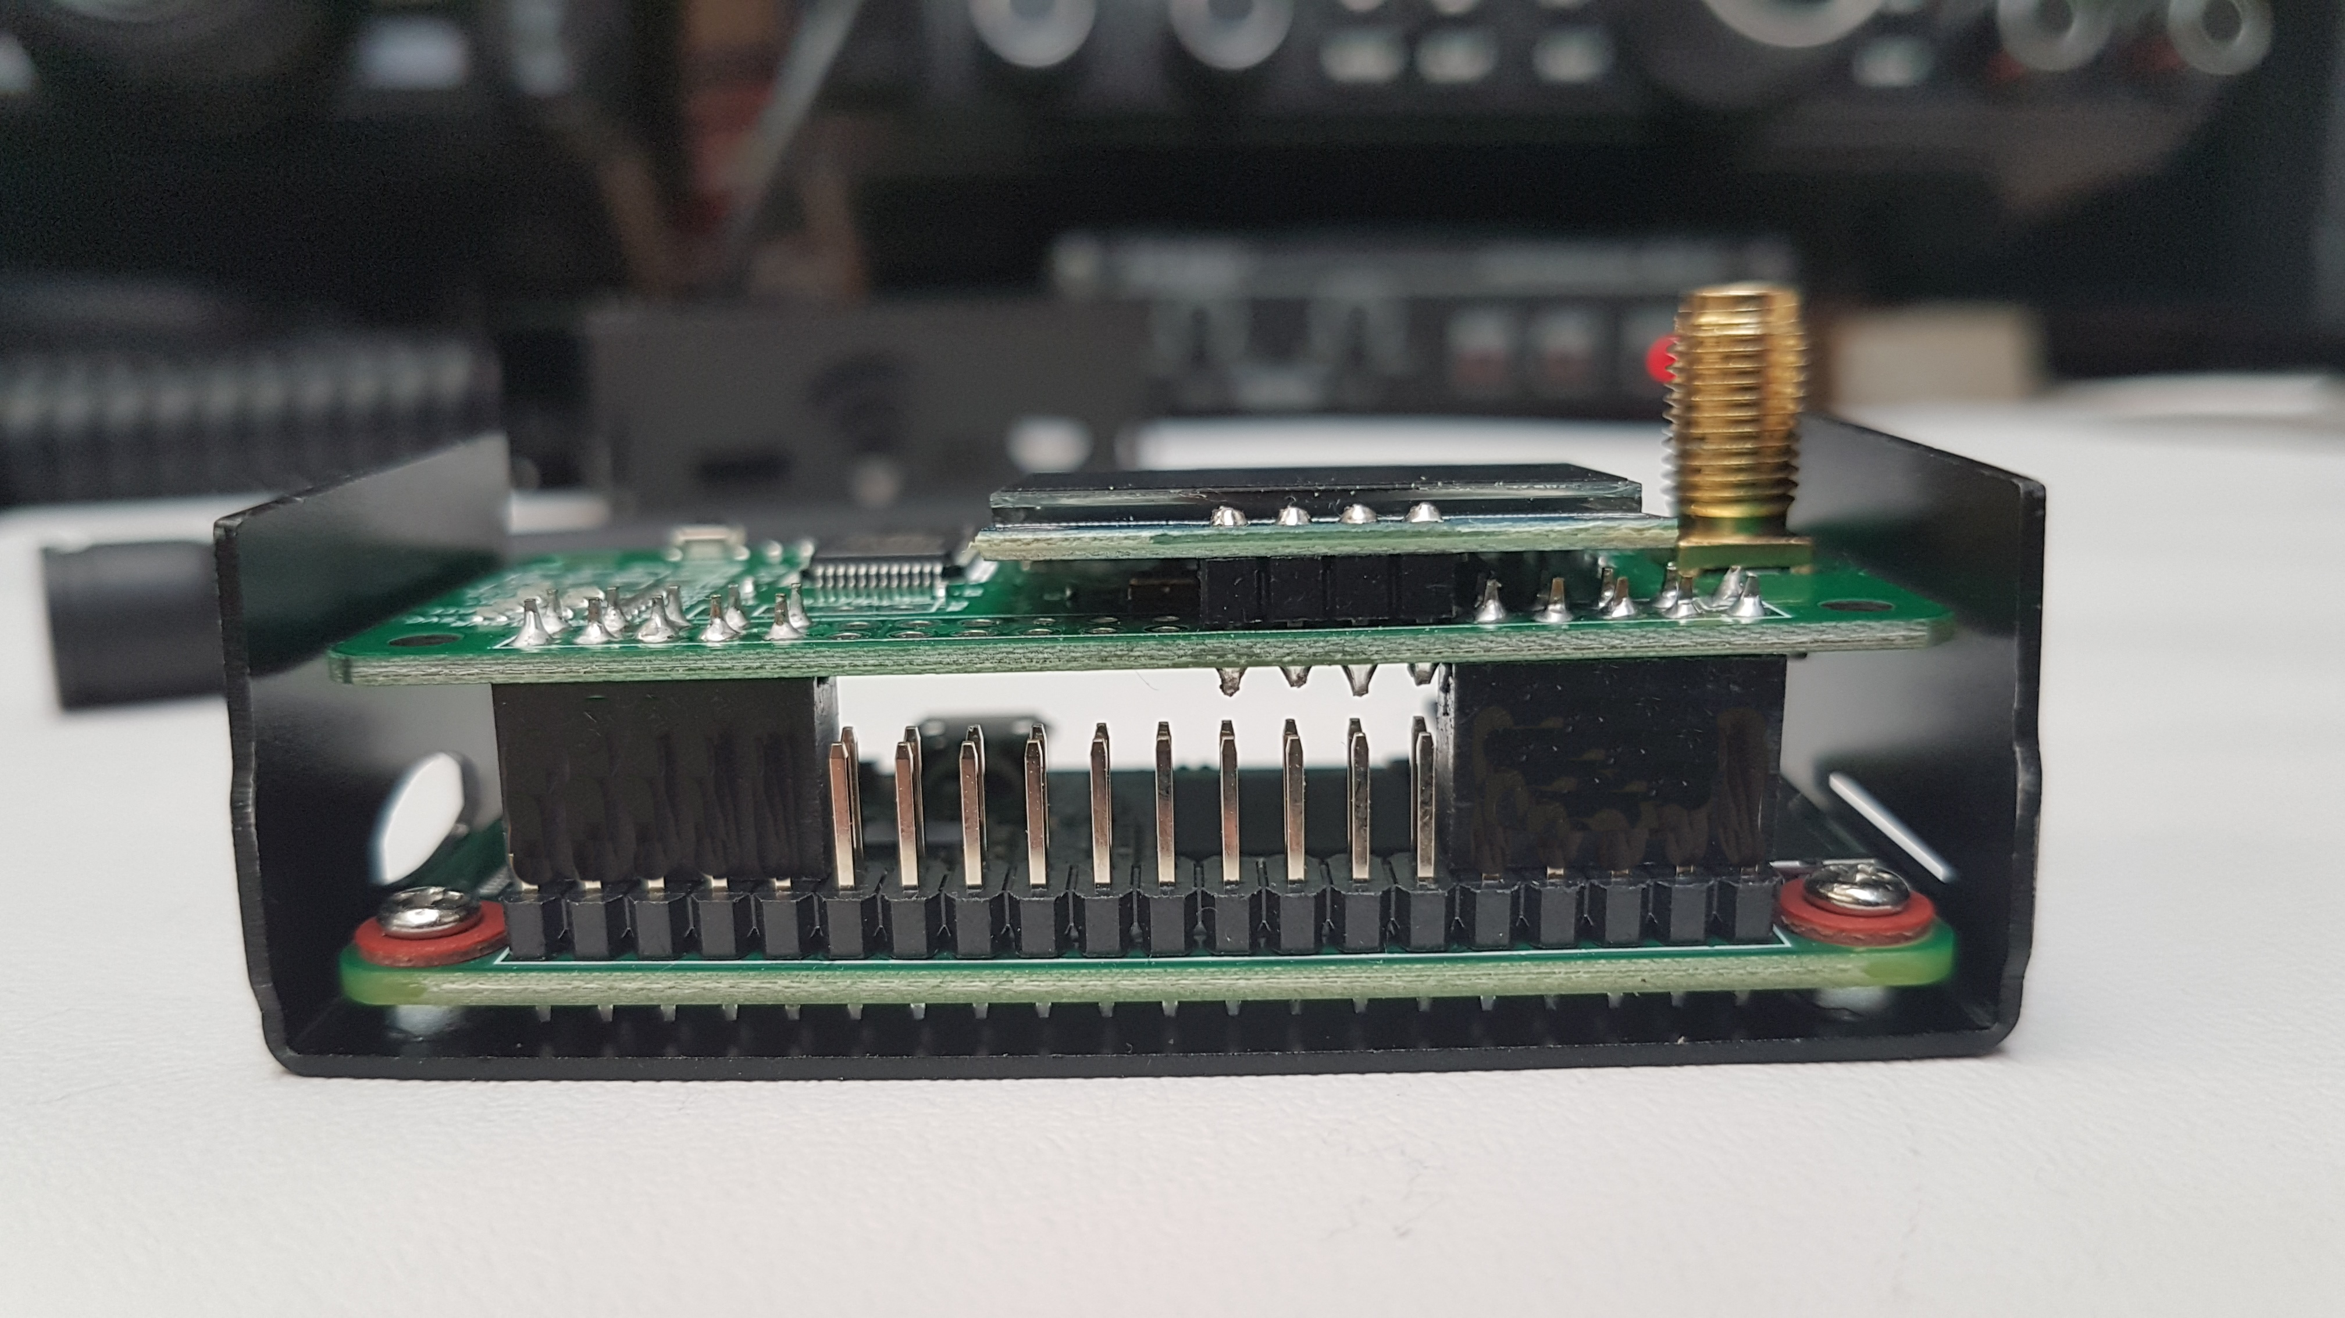
Putting it together
If you purchased the full header version of the Pi Zero W then it’s a good idea to trim down the pins on the underside of the MMDVM board.
So when it goes together the pins don’t touch!

Slide 17
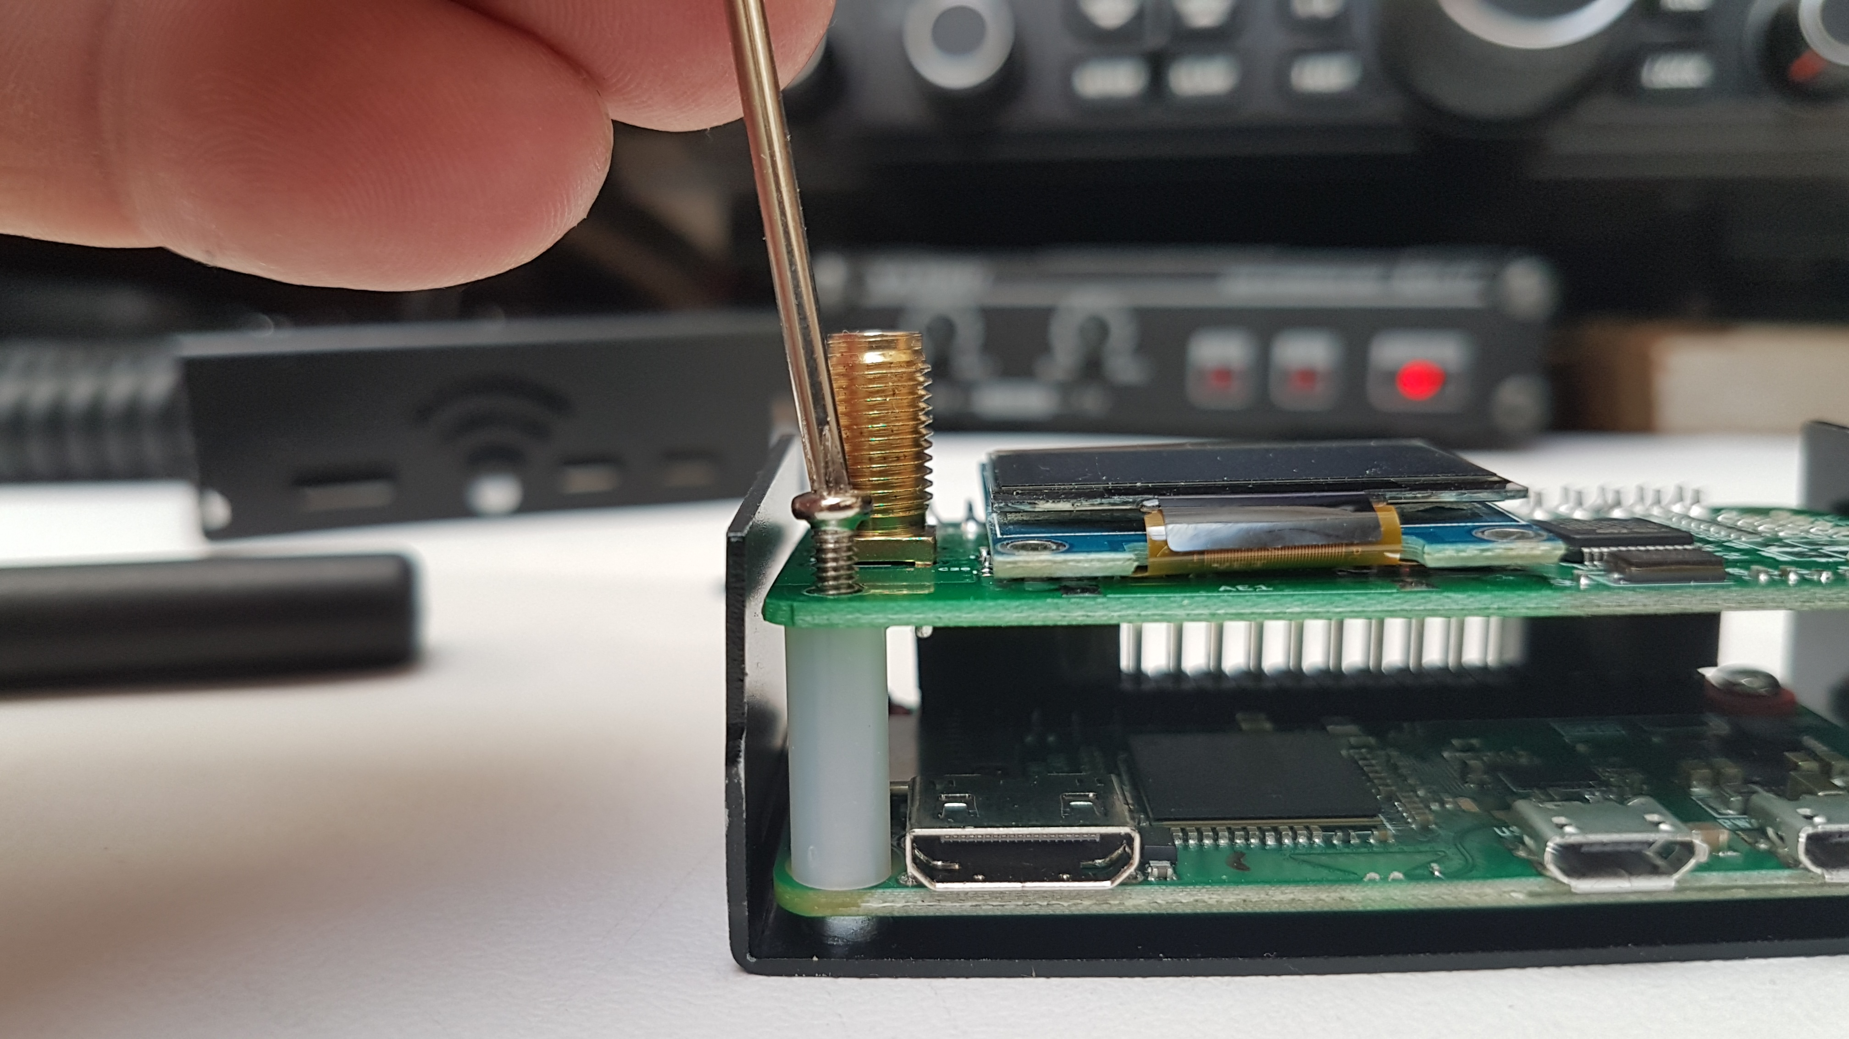
Putting it together
Why did I point out the screws go next to the headers, far side from the power?
So the board supports can go
on the correct side. The pins
support the other side.
I placed them between the
boards and then lined up
with the help of the screw.

Slide 18
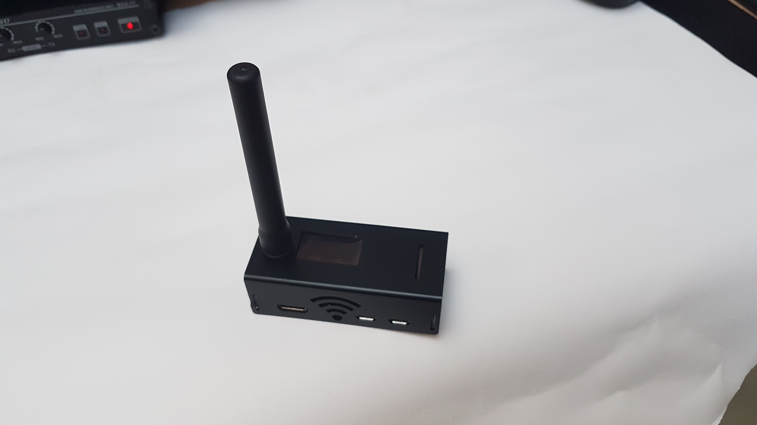
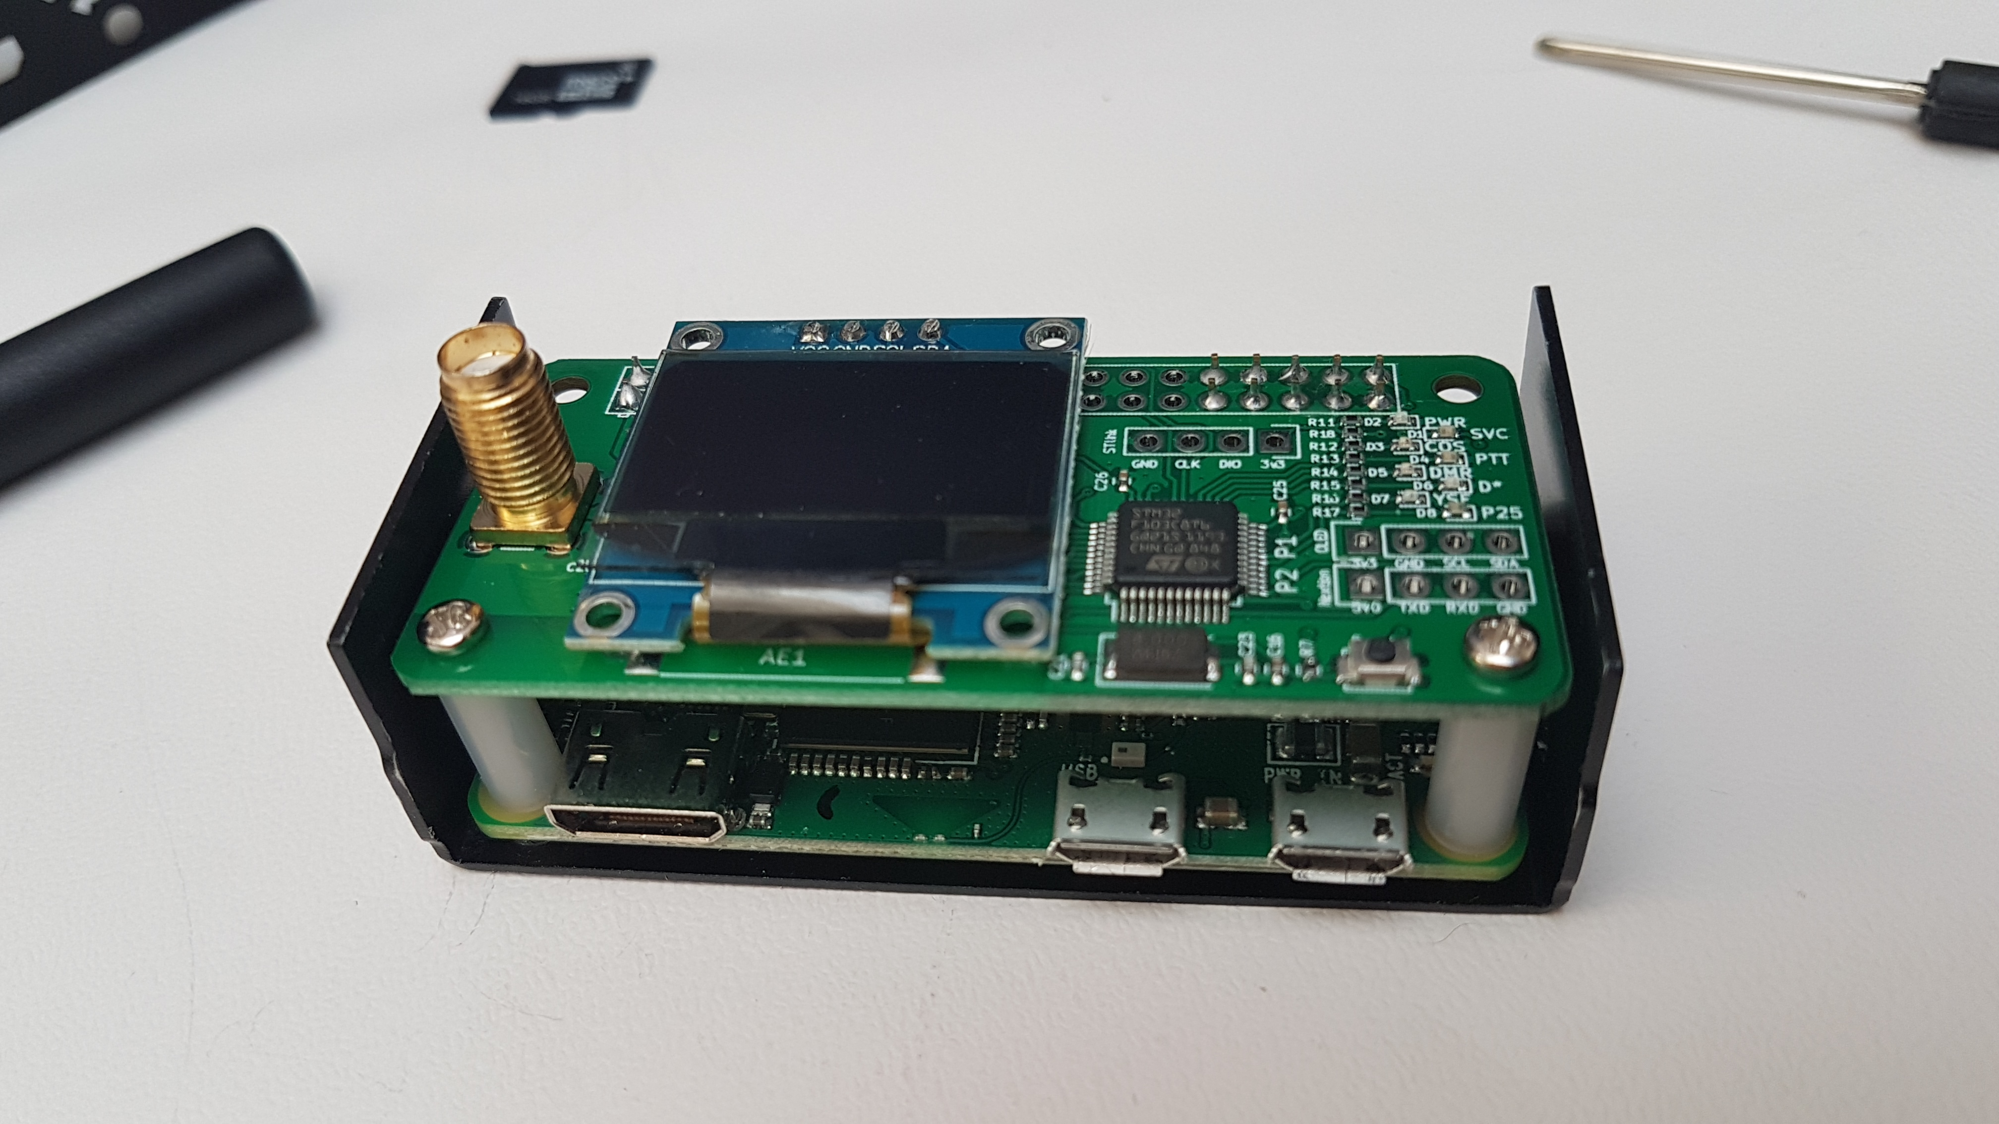
Putting it together
Its built!
Put the lid on!
Put in the micro SD card.
Screw on the antenna.
Done!
Well... Nearly…

Slide 19
Configure the pi-star software.

Slide 20
Configuration
So we have:
Written the image to the micro SD card.
Built the hardware.
Had a cuppa.
Remember the Wi-Fi supplicant? We need to copy it to the root of the micro SD card.

Slide 21
Write wi-fi supplicant file
Using an adapter with the micro SD card copy the supplicant file from the PC to the micro SD card.
Place it on the route of the card.

Slide 22
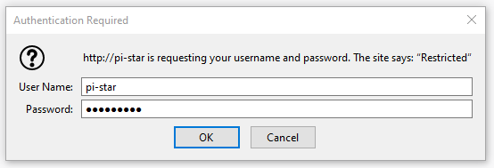
Configuration
The configuration process is performed using the browser application I spoke about way back in the beginning…
So power it up…
You will see the login screen:
Username: pi-star
Password: raspberry
You can change it if you wish.

Slide 23
Configuration
Once logged in you will see this screen:
Then it will move to the main config screen…

Slide 24
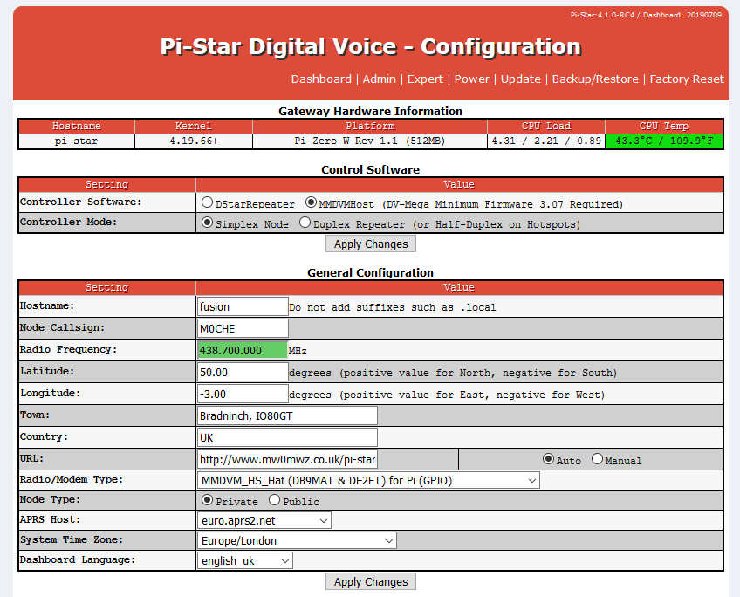
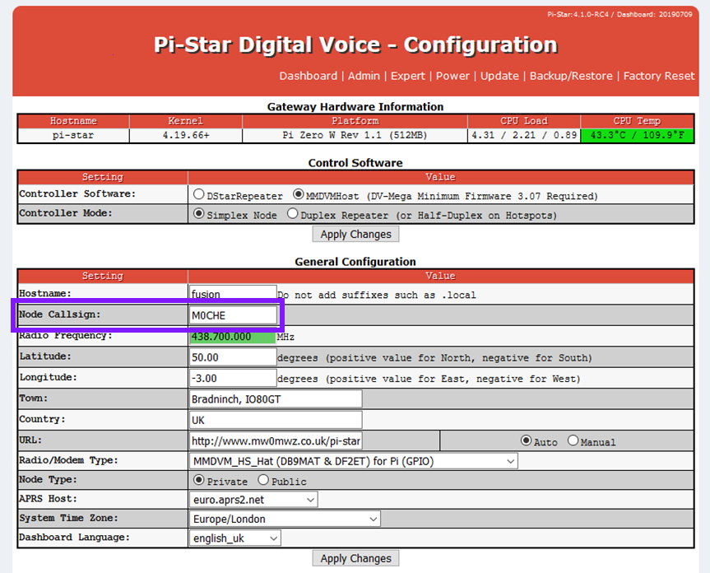
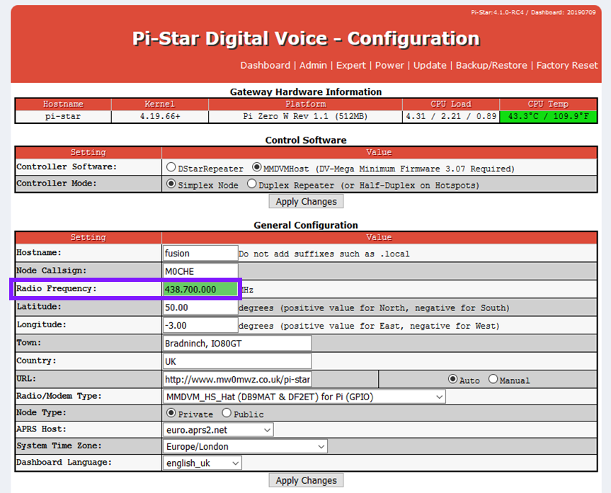
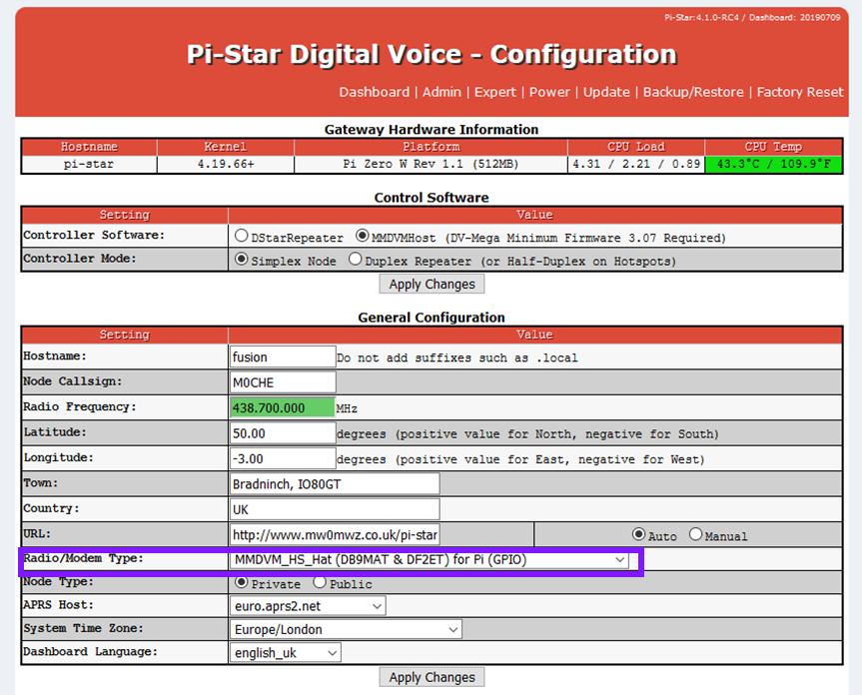
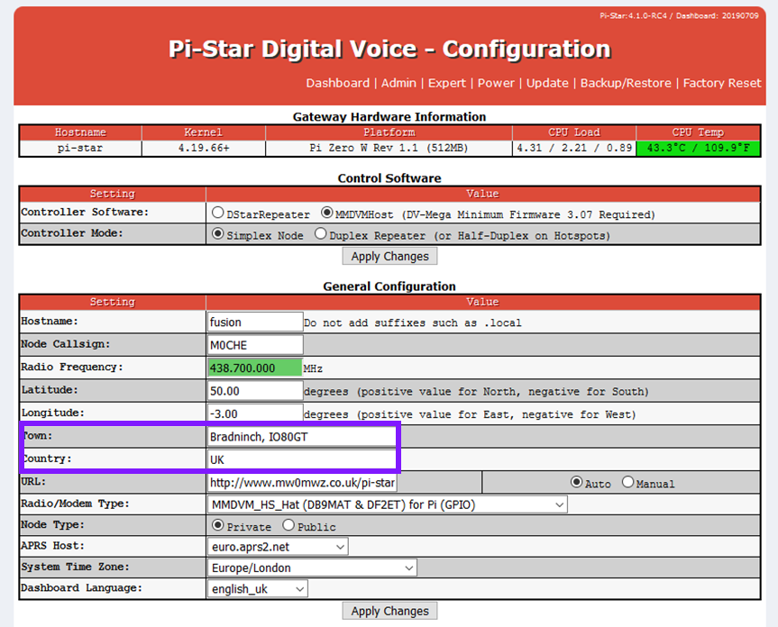
Configuration
There are quite a few things to set here:
Enter your call sign.
Set your frequency.
Name your location.
Select the MMDVM board.
Apply and reboot!

Slide 25
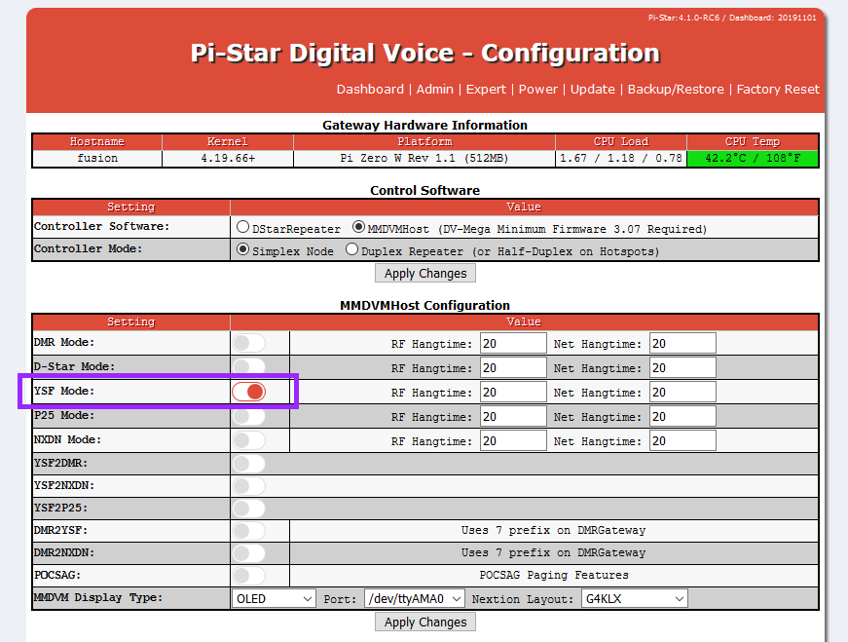
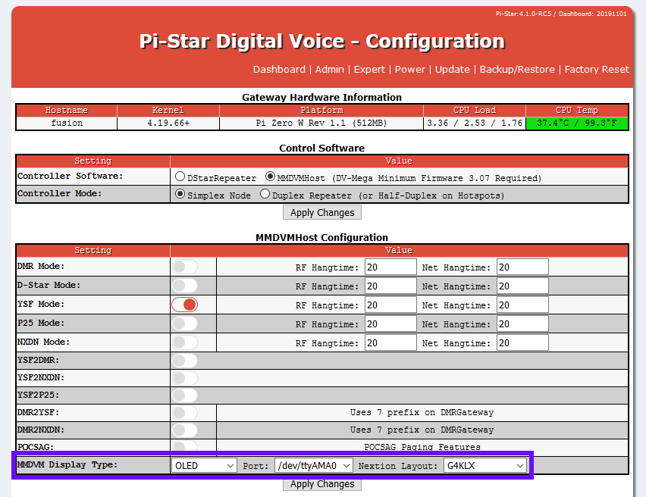
Configuration
Now we have logged back in
we can switch on the mode we
wish to use:
Here I have enabled YSF.
Yaesu System Fusion (C4FM)
Set the screen type
Apply Changes!

Slide 26
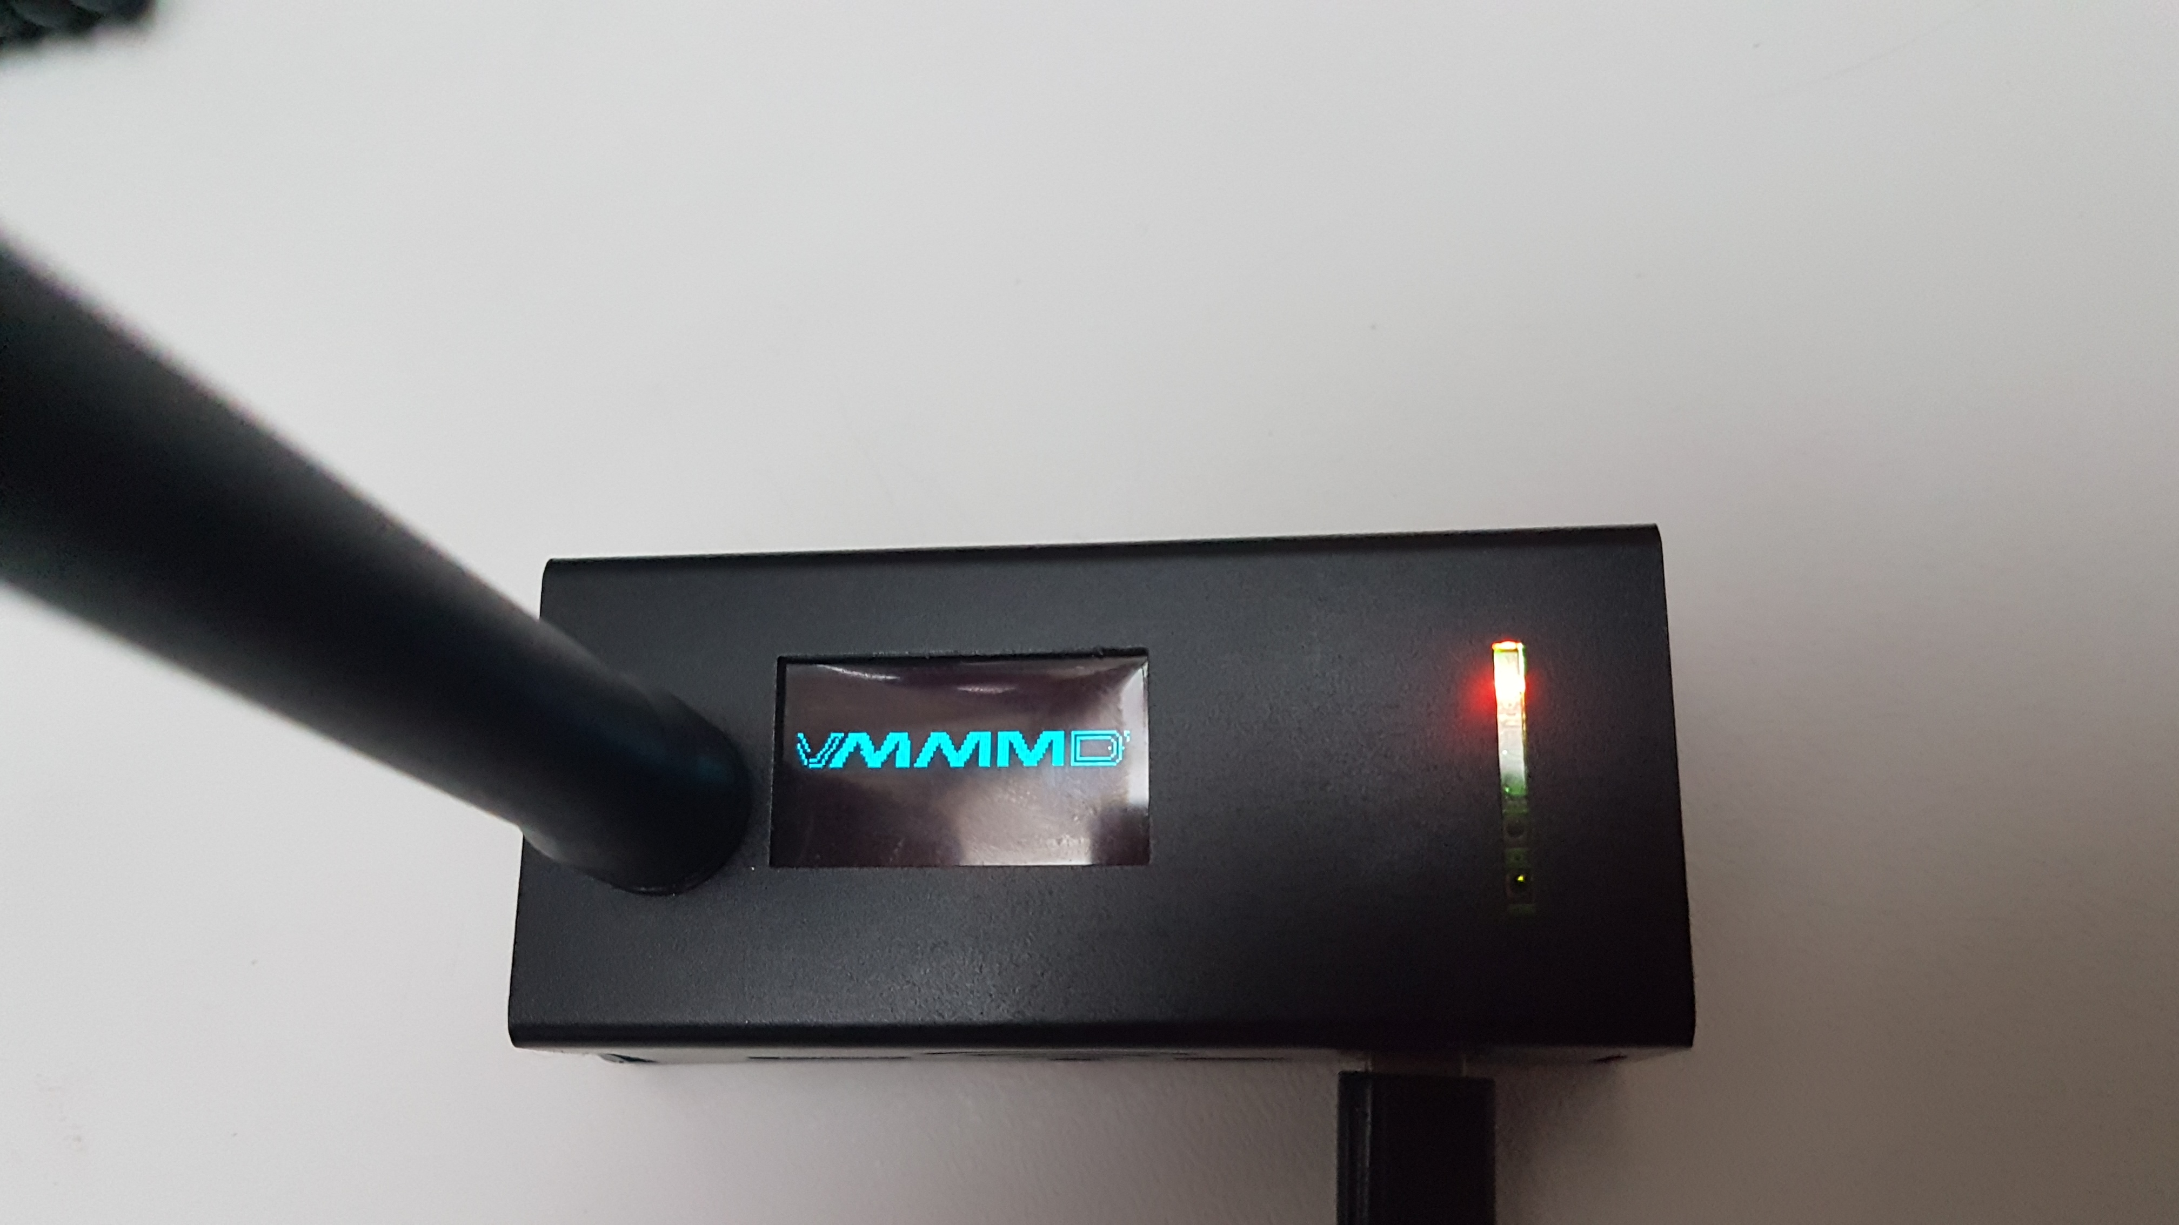
Configuration
Your hot-spot screen should now be active and have a scrolling MMDVM logo.
Log back into Pi-Star.
Username: pi-star
Password: raspberry

Slide 27
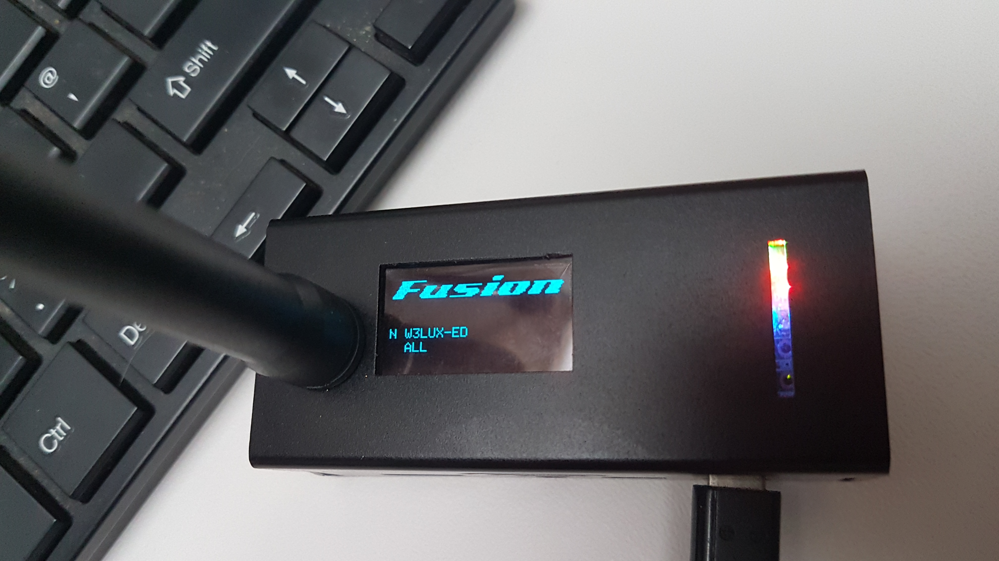
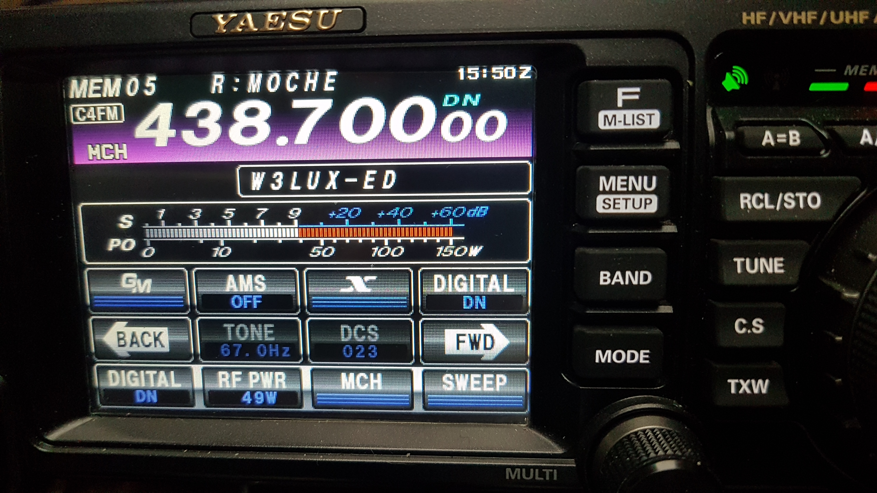
Configuration
That’s that!

Slide 28
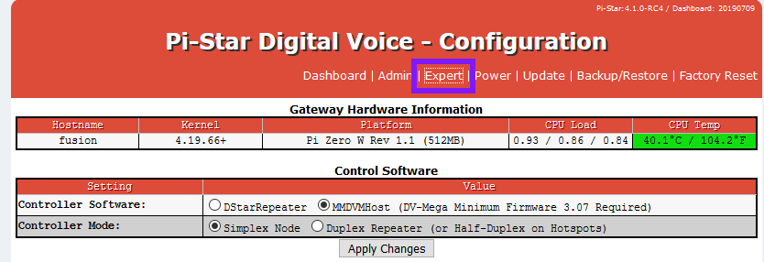
Next steps
Now its all running perform and Update and Upgrade.
Choose Expert

Slide 29
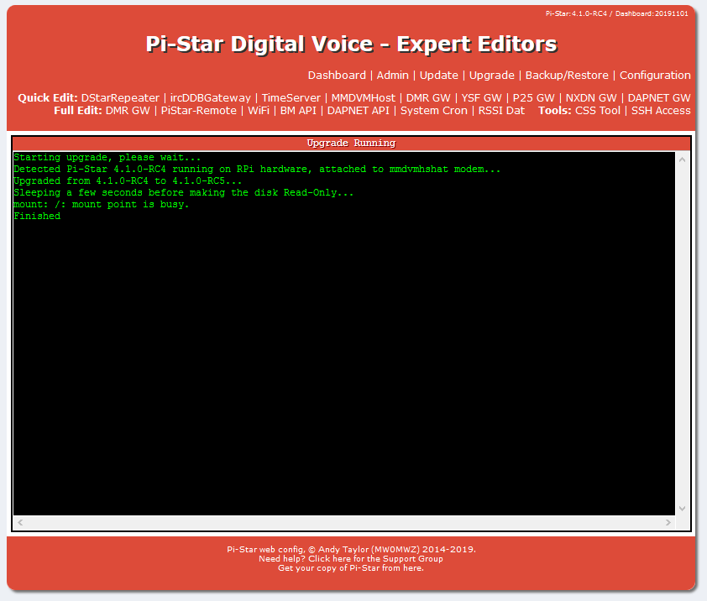
Update and upgrade
NOTICE THE WARNING!
Press Update…
Press Upgrade…

Slide 30
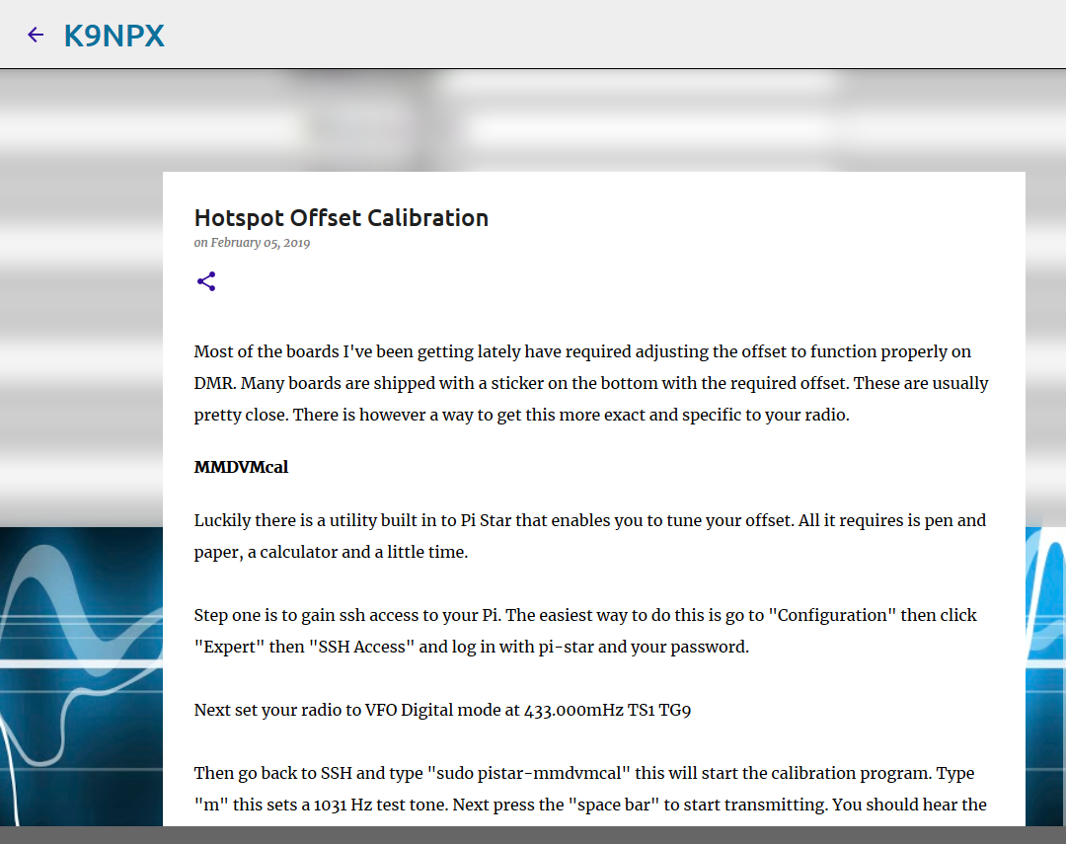
Problem shooting
If you are not hearing anything, or your hot-spot is not responding when PTT is pressed then the offsets will need to be adjusted.
That’s a whole new presentation, but, here is a good place to start.
http://www.k9npx.com/2019/02/hotspot-offset-calibration.html

Slide 31
Enjoy your hot-spot!
That’s the last thing to do, go enjoy it.
Thanks.

